Slide 1


NEMOA National Etailing + Marketing Summit
Ask Us Anything:
Tariffs, Refund Claims & Risks
Presenters: Kevin Haley, David Swetnam-Burland, David Joyce

Slide 2

Disclaimer
We’re lawyers. We may have been your lawyers in the past or we may become your lawyers in the future. Either way, during this presentation, we’re not your lawyers. We’ve made every effort to make this presentation accurate, informational, up-to-the-minute, and entertaining; but it’s not legal advice. If, after hearing us, you think you need legal advice, reach out to your lawyers—who may or may not be us.
*Images courtesy of Wikimedia Commons & Unsplash

Slide 3
Agenda
Where’s my (IEEPA tariff) refund?
From the CIT to the Supreme Court and back again
What’s happening at the CIT?
What can you do about it?
What about the other tariffs?
The balance-of-payments tariffs and the states’ response
US Trade Rep. investigates 60 countries for unfair trade practices…and then what?
Consumer class actions

Slide 4
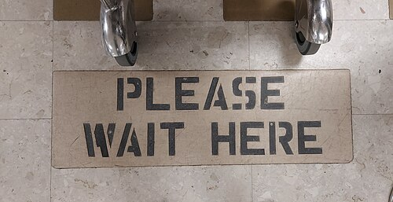
IEEPA tariffs invalid…refunds?
Feb. 20, 2026: Supreme Court declares emergency tariffs invalid
Looking ahead: no more IEEPA tariffs
Looking behind: no discussion of remedies/refunds
Mar. 2026: Case returns to the CIT
The CIT picks one case (Atmus, now Euro Notions) and one judge (Eaton)
Thousands of refund cases on ice
Judge Eaton orders CBP to refund all IEEPA tariffs to all affected importers
Mar.-Apr. 2026: CBP gets to work on “CAPE”

Slide 5

What is “CAPE”?
The CAPE Claim Portal: web-based entry point for importers and brokers to submit IEEPA refund requests to CBP
Filers will be able to upload a Comma-Separated Values (CSV) file containing a list of the entry summaries for which they are requesting IEEPA refunds
Apr. 10, 2026: CBP launches CAPE website: https://www.cbp.gov/trade/programs-administration/trade-remedies/ieepa-duty-refunds

Slide 6
“CAPE” To Do
Register for the Automated Commercial Environment (ACE) Portal
Update ACH banking information
As of March 26, 26,664 IORs ready to receive electronic refunds – covers approximately 78% of entries with IEEPA duties
Collect data for all IEEPA tariffs
Note which entries have liquidated

Slide 7
“CAPE” Phase 1
Only the importer of record can file
Phase 1 limited to unliquidated entries and entries liquidated within the preceding 80 days
Phase 1 will cover approximately 63% of entries
CAPE will remove IEEPA duties and recalculate
CBP estimates a 45-day period to review and liquidate entry summaries

Slide 8
“CAPE” Subsequent Phases
Entries liquidated and finalized with IEEPA duties
Entries with an open protest
Ability to process complex entries or entries flagged for reconciliation

Slide 9

What can you do now?
File/monitor CIT legal proceedings
Prep for payments—get smart on CAPE
Maintain up-to-the minute payment documentation
Bear in mind the potential for offsets of other duties
Monitor deadlines for post-summary corrections and protests
Look to limit future tariff effects (e.g., first sale for export)

Slide 10
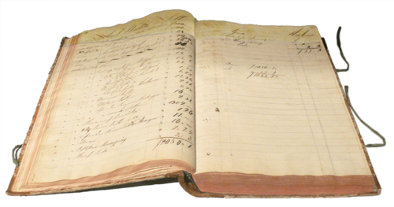
What’s next? Balance-of-payments tariffs
Balance-of-payments tariffs (section 122)
Nixon-era law authorizing temporary import surcharges to address balance-of-payments deficits
Rate capped at 15%; duration limited to 150 days unless extended by Congress
Feb. 20, 2026: announced
April 10, 2026: 3-judge panel heard argument on states’ legal challenge

Slide 11

Unfair trade practices tariffs
Section 301 of the Trade Act of 1974
US Trade Rep. can investigate and remedy trade practice by a foreign government that violate a trade agreement or is “unjustifiable” and “burdens or restricts” US commerce—including through tariffs
Feb. 20, 2026: USTR announces “accelerated timeline”
Mar. 17, 2026: USTR to investigate 60 countries for not curbing “forced labor” elsewhere

Slide 12
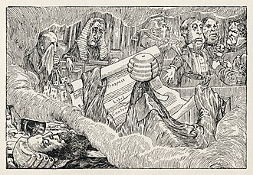
Consumer class actions
Complaint against Costco filed in federal court in Illinois
Alleges Costco will be unjustly enriched because it passed tariff costs to consumers and collected refunds
That hasn’t happened yet
Complaint against FedEx filed in federal court in Florida
Seeks to recover import duties and brokerage fees
Demonstrates what happens when $150+ billion is at stake

Slide 13
What can you do now?
File/monitor CIT legal proceedings
Prep for payments—get smart on CAPE
Maintain up-to-the minute payment documentation
Bear in mind the potential for offsets of other duties
Monitor deadlines for post-summary corrections and protests
Look to limit future tariff effects (e.g., first sale for export)

Slide 14
Any Questions?
Kevin Haley
khaley@brannlaw.com
David Swetnam-Burland
dsb@brannlaw.com
David Joyce
djoyce@brannlaw.com

