Slide 1
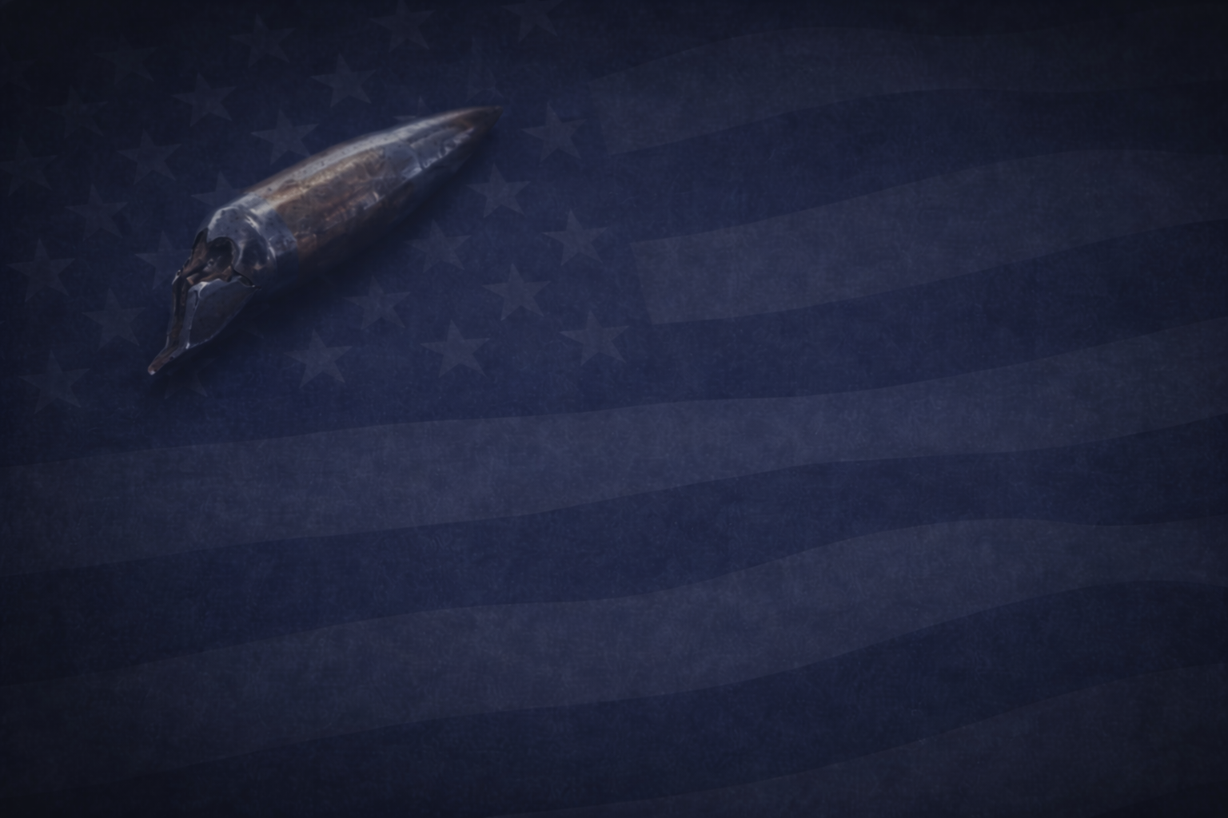
Patrick D. Nugent
FIND A WAY

Slide 2
July 12th, 2017

Slide 3


Slide 4
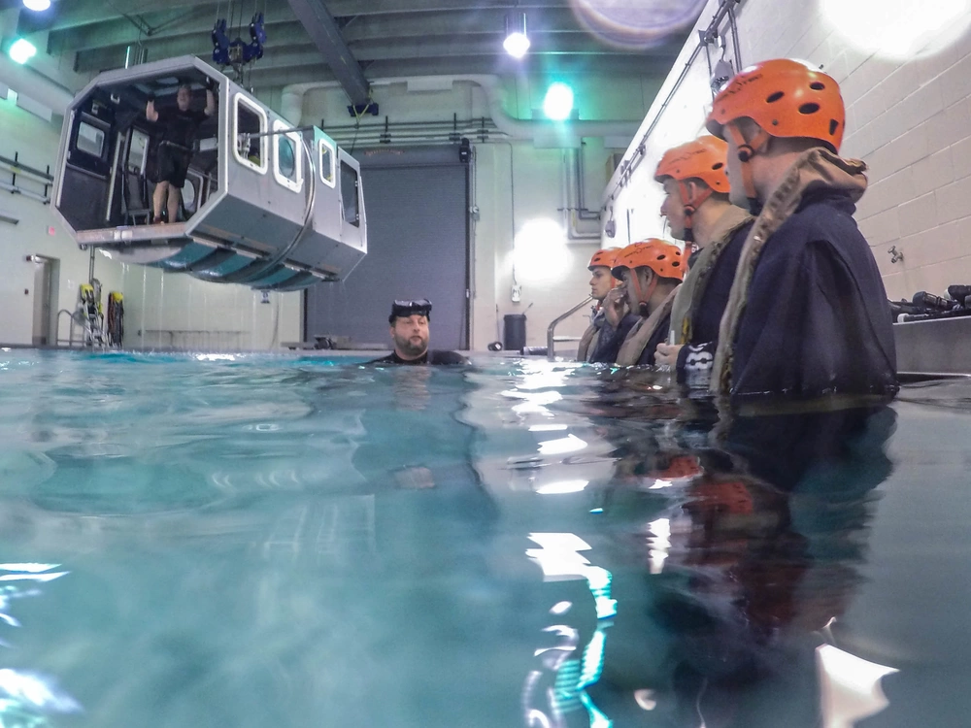

Slide 5
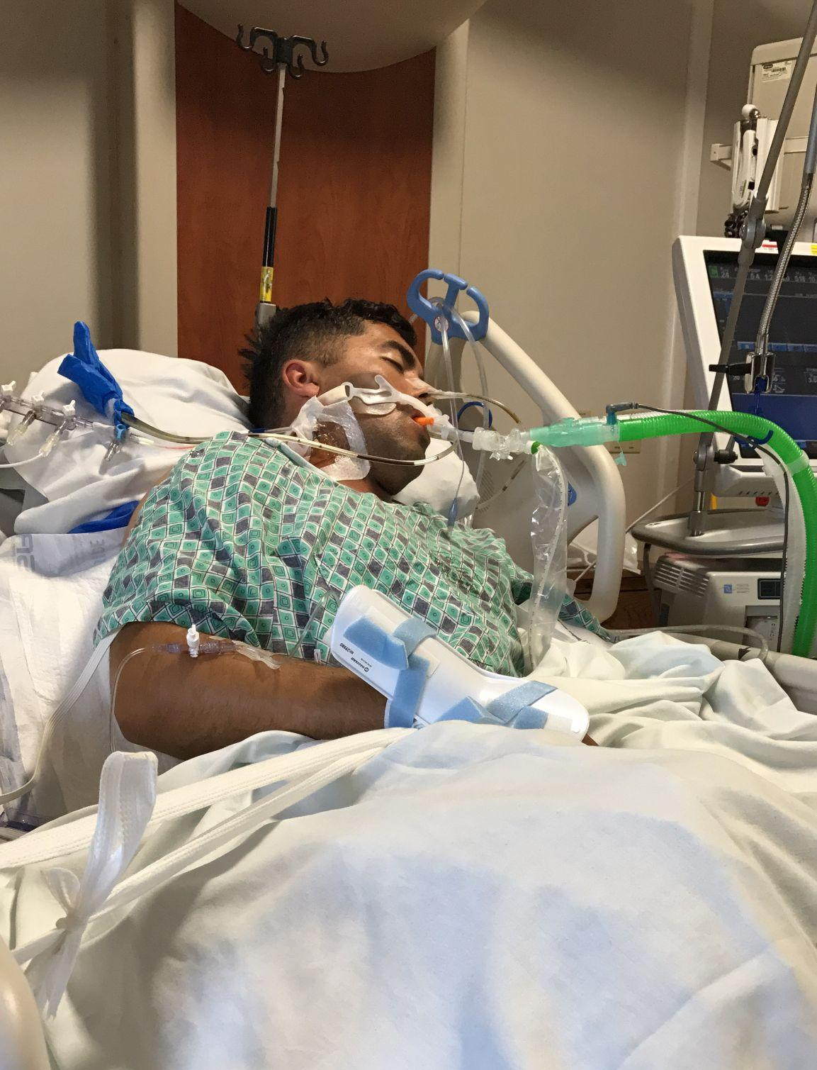

Slide 6
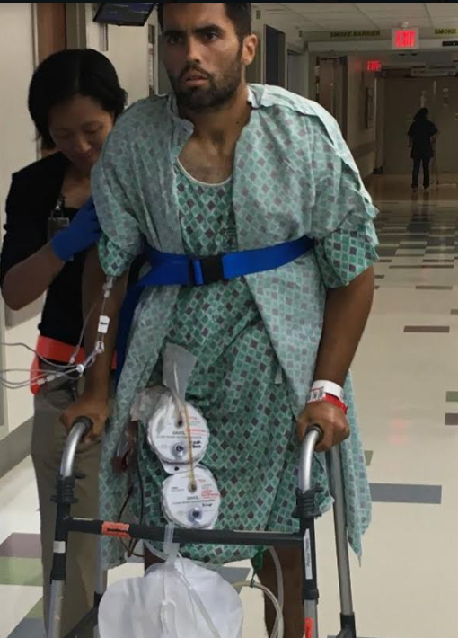

Slide 7


Slide 8
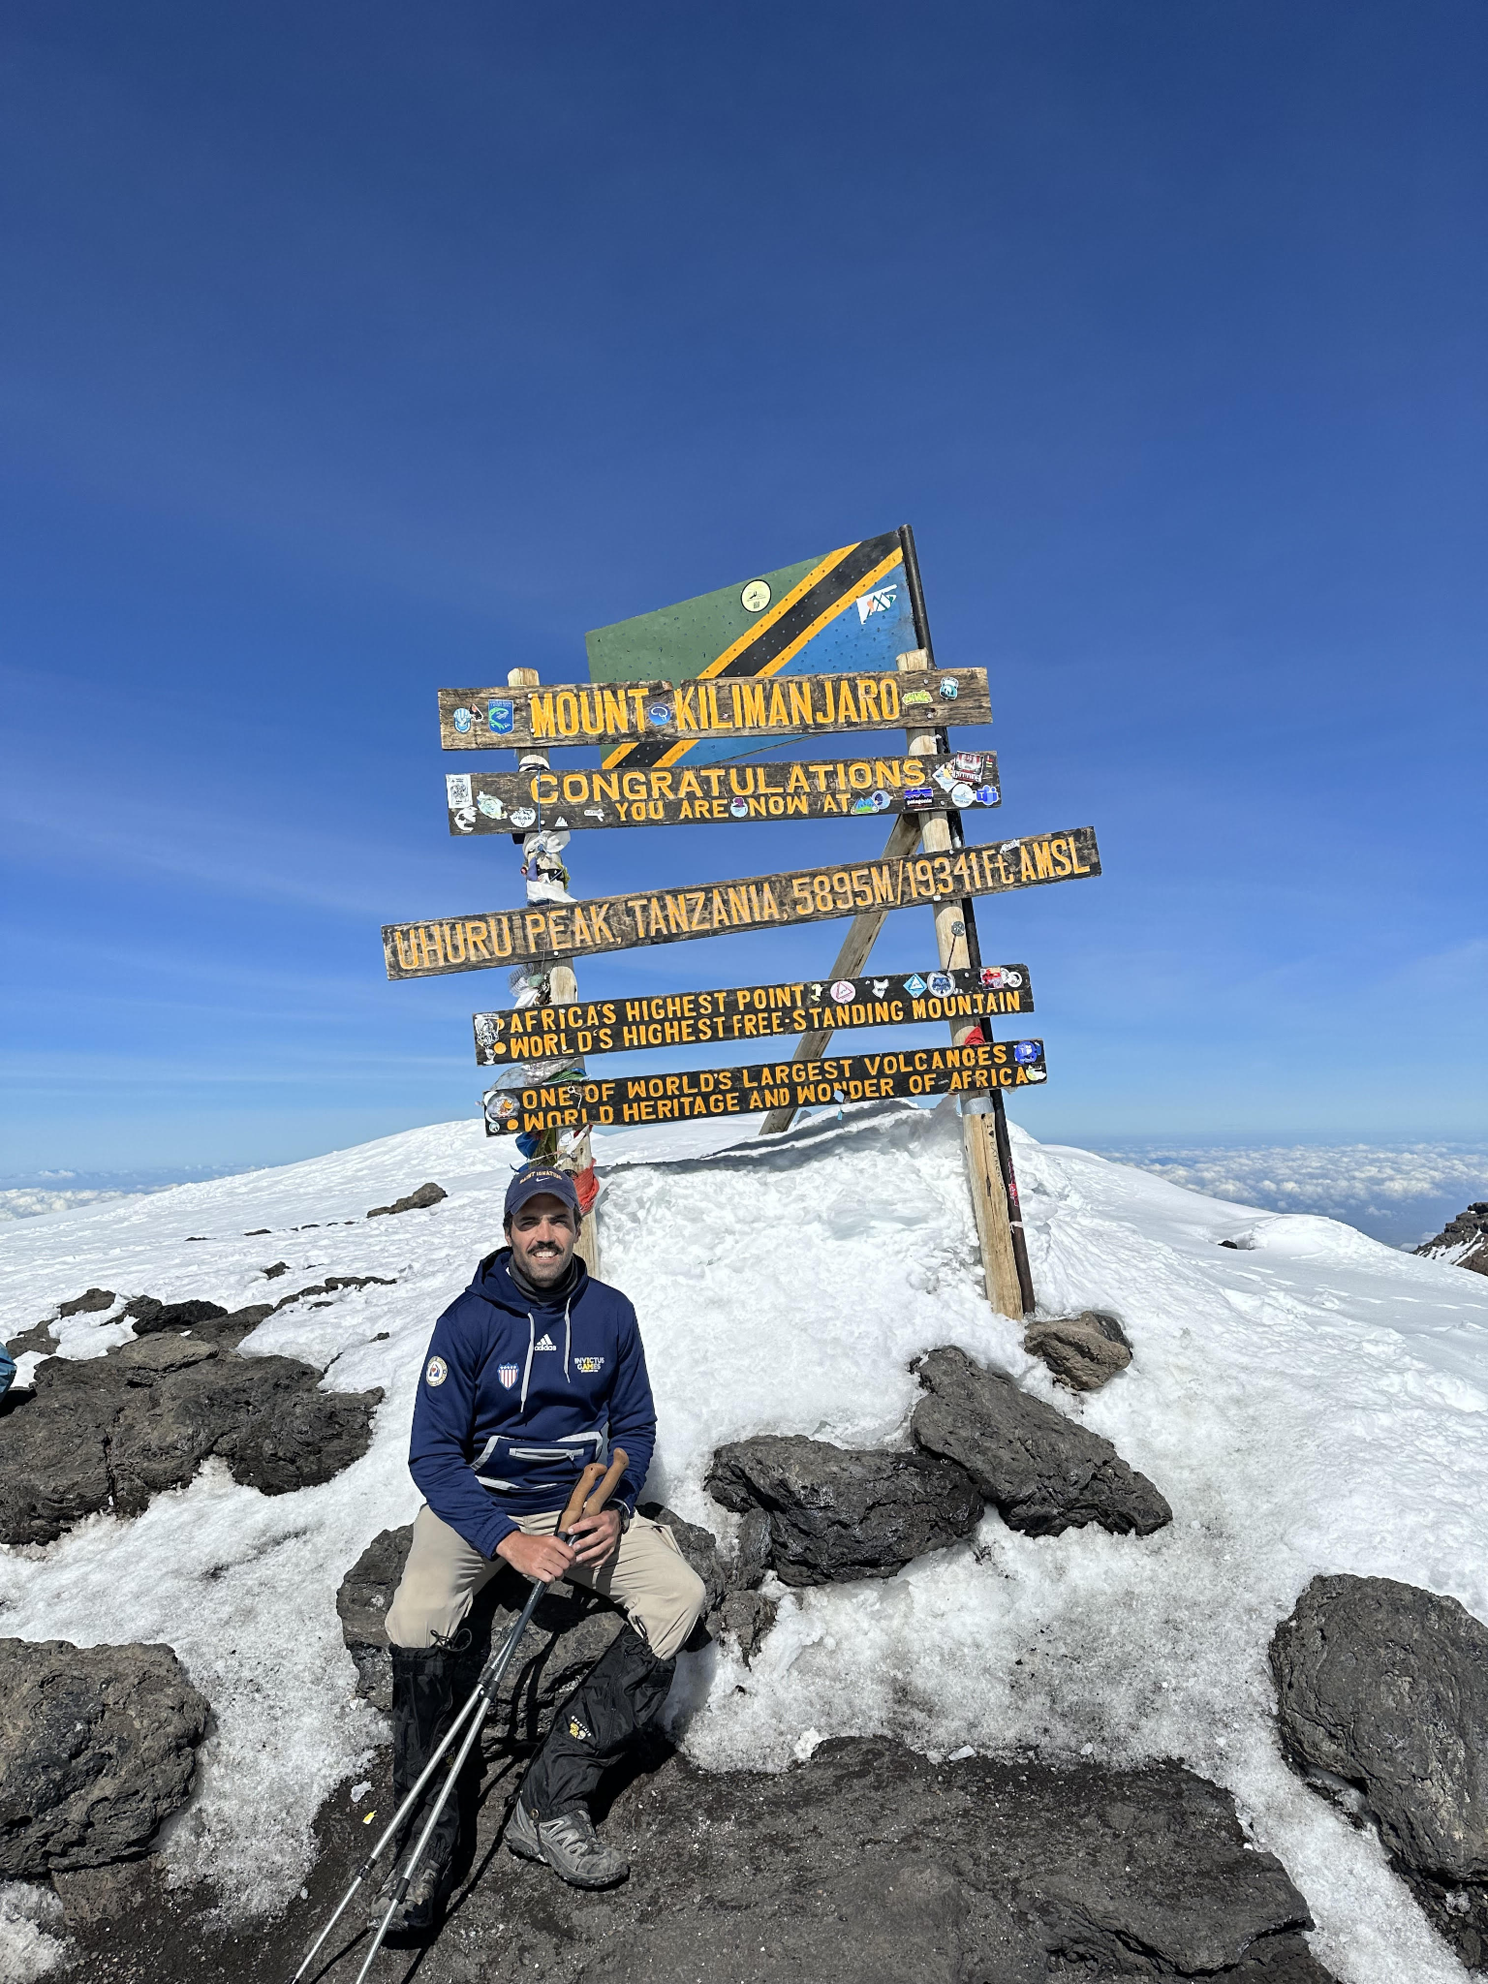

Slide 9
Find A Way: The GRIT Method
G — Grow Your Grit
R — Regulate Your Response
I — Insist on Finishing
T — Turn Pain into Service

Slide 10

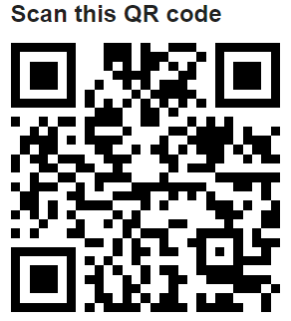



FIND A WAY
Follow my journey: @pdnuge
Contact me: hello@patrickdnugent.com

