Slide 1
TOWN HALL MEETINGHALL
Steve August, President of NEMOA
VP, Marketing - Road Scholar

Slide 2
Treasurers Report
Tammy Senft, Treasurer of NEMOA

Slide 3
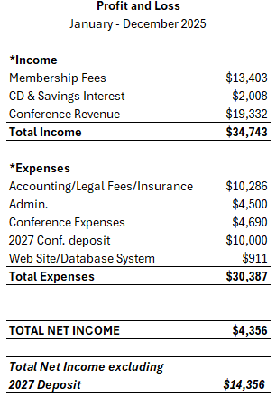
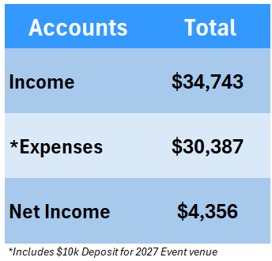
treasurers Report
Notes:
Net Income includes -$10k for 2027 Event Deposit.

Slide 4
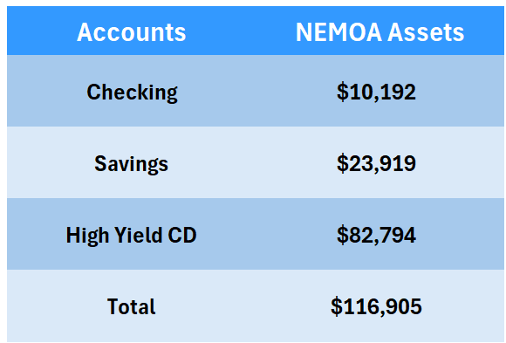
treasurers Report
Notes:
High Yield CD 4.35% APR.
Very stable with $1k total funds vs. LY and that includes the -$10k for 2027 deposit

Slide 5
President’s Report
Steve August, VP Marketing Road Scholar

Slide 6
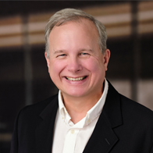
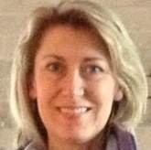
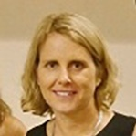

NEMOA Officers
Steve August
Board President
Road Scholar
Tammy Senft
Treasurer
Consultant
John Rossiter
Board Vice President
Lindenmeyr Central
Pam Higgins
Board Secretary
Wiland

Slide 7

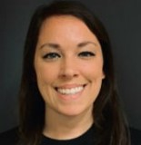
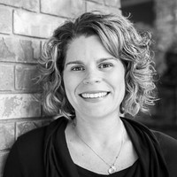
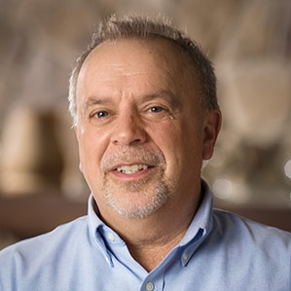
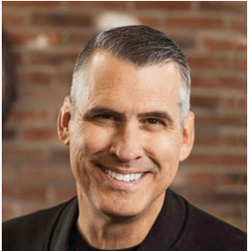
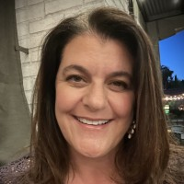

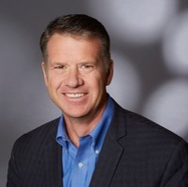
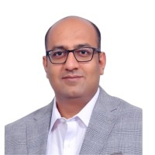
NEMOA Board MEMBERS at Large
Dana Springfield
Dover Sadlery
Stephanie Stopka
Design Toscano
Emily Treske
The Vermont Country Store
Brent Niemuth
J. Schmid
Christine Page
Epsilon
Dana Pappas
Neil Patrick
L’Occitane
Brian Rainey
Path2Response
Alok Jain
Affordable Care

Slide 8
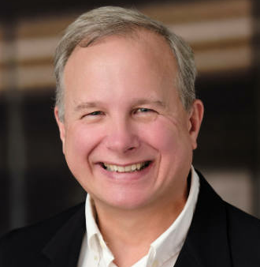
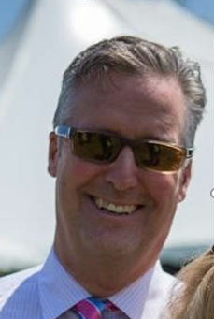


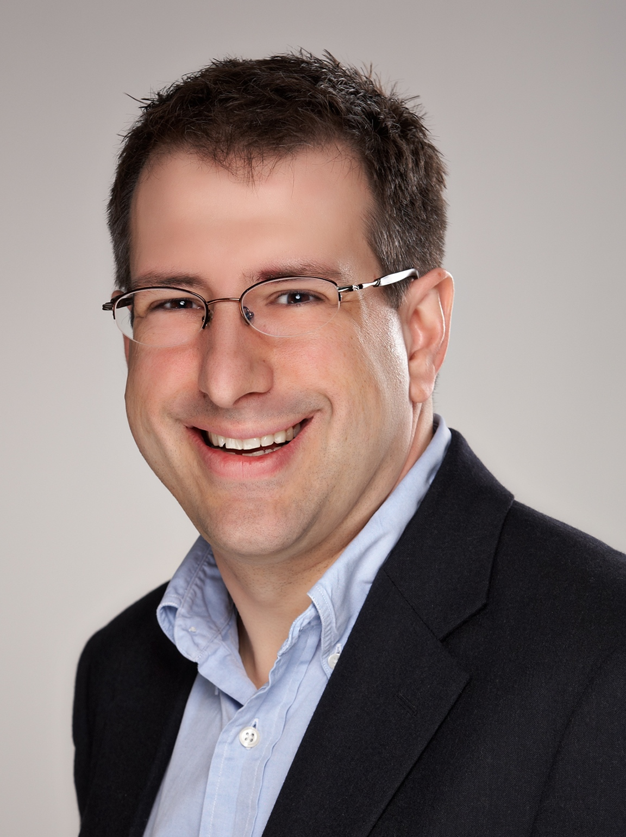
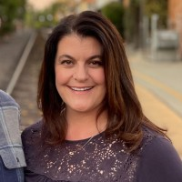
Your NEMOA BOARD OF DIRECTORS
Steve August
PRESIDENT
Road Scholar
Pam Higgins
SECRETARY
John Rossiter
VICE PRESIDENT
Lindenmeyr Central
Tammy Senft
TREASURER
Consultant
Dana Springfield
PAST PRESIDENT
Dover Saddlery
Dana Pappas
PAST PRESIDENT
Plow & Hearth
Brian Rainey
At Large
Path2Response
Stephanie Stopka
At Large
Design Toscano
Brent Niemuth
At Large
J. Schmid
Neil Patrick
At Large
L’OCCITANE
Alok Jain
At Large
Affordable Care
Christine Page
At Large
Epsilon
Emily Treske
At Large
Vermont Country Store

Slide 9
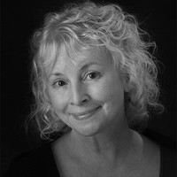
NEMOA MEMBERSHIP AMBASSADOR
Janie Downey
janie@nemoa.org
First NEMOA Spring 1990
NEMOA Board 2000-2007
NEMOA Executive Director 2007-2011
NEMOA Membership Amb. 2025-

Slide 10
Membership Benefits
  NEMOA Job Board
  Ability to nominate a rising star
  Nominations for Lifetime Achievement Award
  Eligible for Board Participation
  Access to past summit presentations & material online
  Connection to board members
  *Membership fee has remained the same for nearly a decade*

Slide 11
Presidents Report
Key Accomplishments
  Strengthening Financials
  Membership database update
  ACMA collaboration
  New content structure for the summit
  Increased AI focus with pre-sessions
Coming up:
  NEMOA Inside Track - 4th Thursday of the month
  First one May 28th @ Noon

Slide 12
Thank You

