Slide 1
2026 Recognition

Slide 2
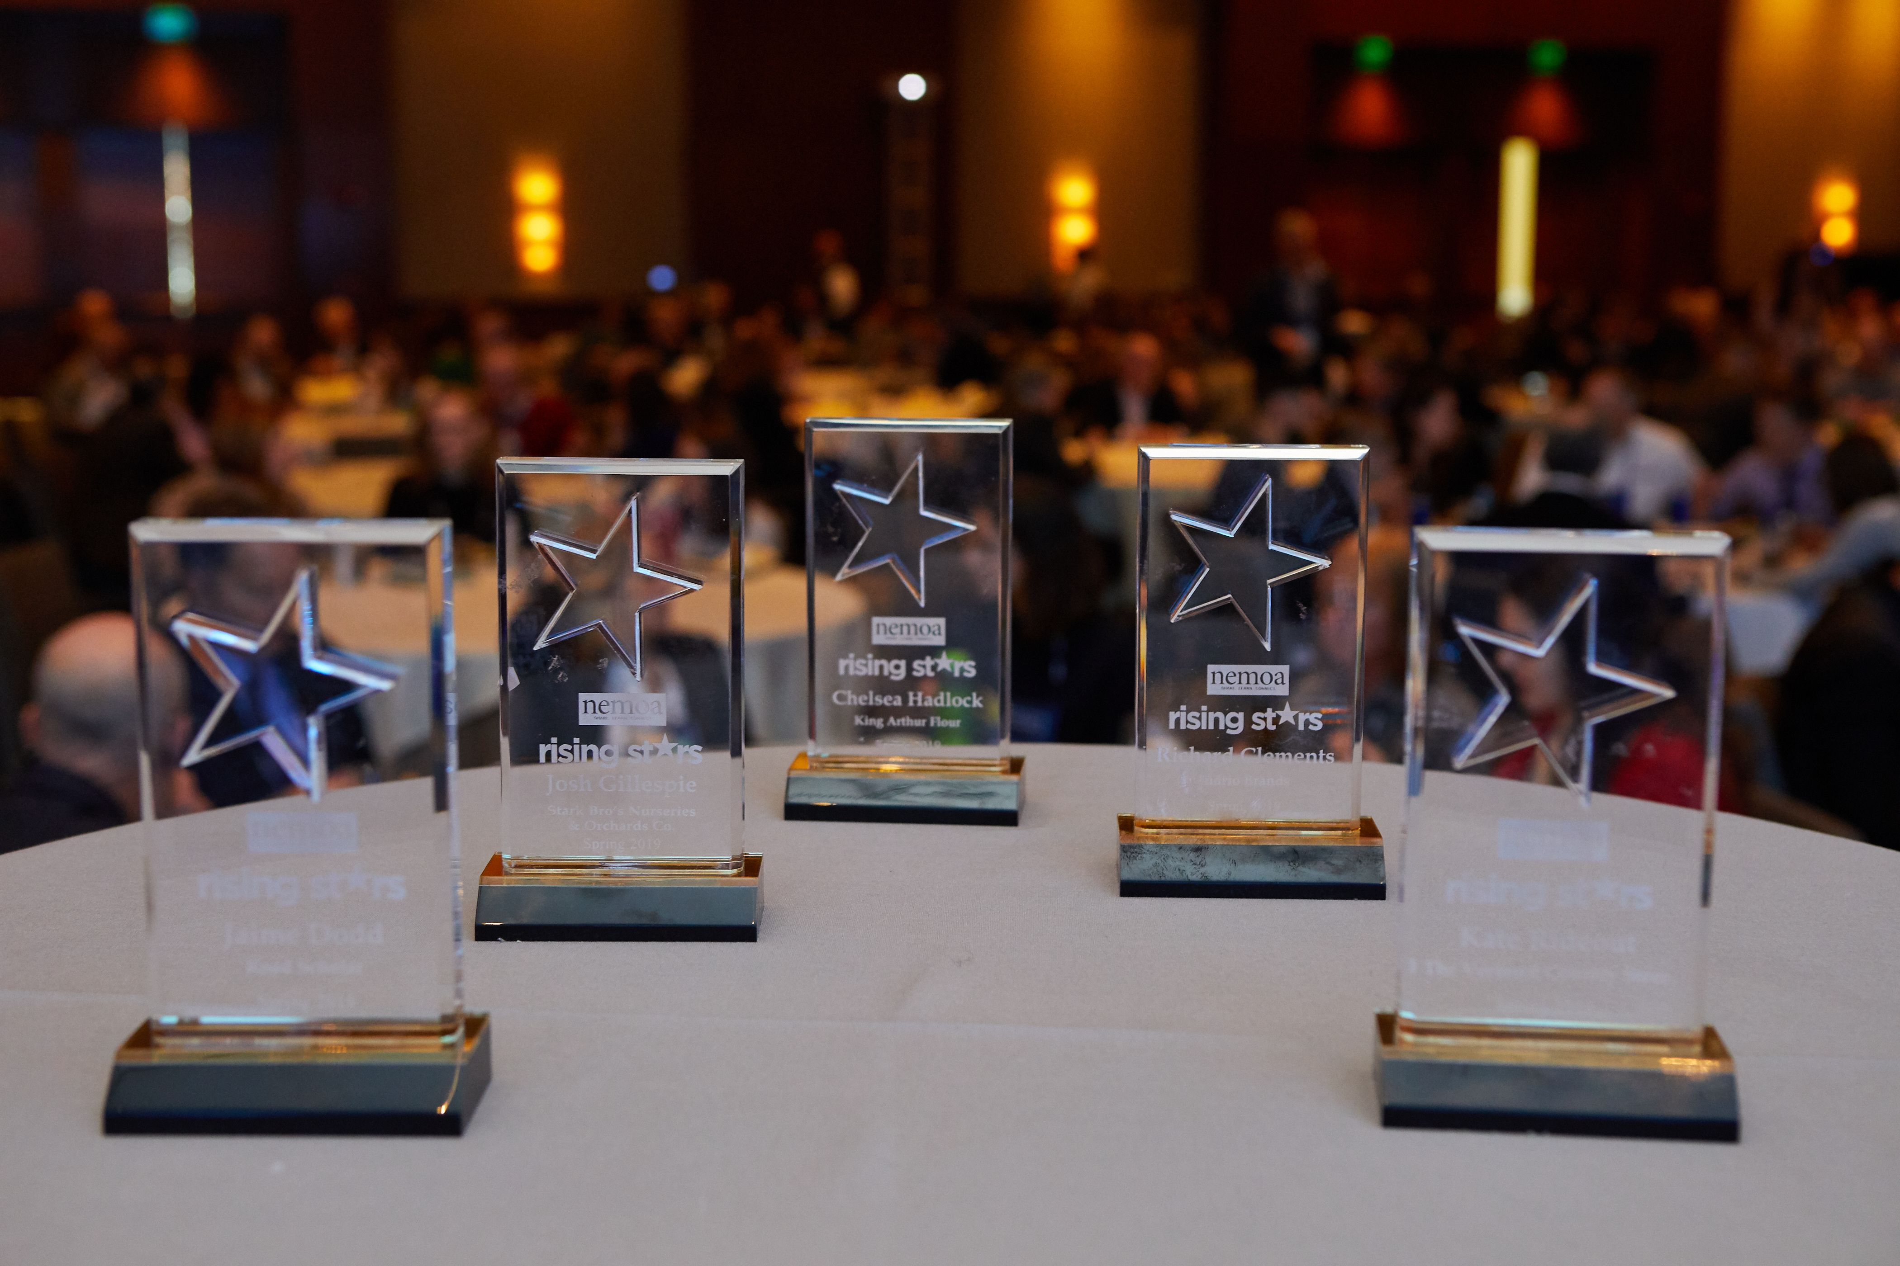
2026 Rising stars

Slide 3
2026 Rising stars
Meghan Meadus – Cross Country Computer
Maycee Fishel – Road Scholar
Sydney Scruggs – Epsilon
Samantha Hontas – The Vermont Country Store
Erin Wojciechowski – Smart Meter

Slide 4
Peer recognition

Slide 5

Lifetime achievement award
2005 – Joan Burden Litle, Catalog Connection
2006 – Peter G. Rice, Founder, Plow & Hearth
2012 - Bob Allen - President/CEO, Vermont Country Store
2015 - Russ Gaitskill - President, Garnet Hill
2016 - Chris Bradley - President, Cuddledown
2019 - Bob Webb - VP Marketing, Potpourri Group
2021 - Cindy Marshall - CEO, Shine Strategy
2023 - Lois Brayfield – Former President and CEO, J. Schmid
2023 - Karen Mayhew – Former SVP of Marketing at DataAxle
2024 – Phil Wiland – Founder and Former CEO of Wiland
Notes:
What the award is and why it is handed out

Slide 6
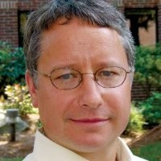


Jim Hall

Slide 7


