Slide 1




Beyond ROAS
A Causal Measurement Clinic
Madan Bharadwaj
Founder & CEO
madan@msquaredattribution.com
https://m-squared.com/
Tammy Senft
Marketing Strategy Consultant
tamarasenft225@gmail.com
The National ETailing + Marketing Summit

Slide 2
Agenda
Module 1: Crash course in Causal Attribution
1
10-15 mins
Module 2: Case study - Reading an Incrementality Test
2
10-15 mins
Module 3: Workshop: Forecasting with Casual Metrics
3
10-15 mins
Module 4: Q&A
4
10-15 mins

Slide 3


MODULE 1
Crash course in Causal Attribution

Slide 4

Market Shift
Consumer behavior has changed fundamentally, but Attribution has stayed about the same for the last 20 years

Slide 5








Consumer’s Journey with your brand is now Cross-channel
Your brand gets touched by a typical consumer across multiple media platforms before they transact on your site
Market Insight
---------------------------
Your brand gets touched by a typical consumer across multiple media platforms before they transact on your site
YourSite.com

Slide 6



But Attribution is mostly last click
Market Insight
---------------------------
100%
Last Click attribution ignores every touch before the last touch
YourSite.com

Slide 7




This shows up in your data
Site Analytics Attributed Conversions
14k
Google Analytics over-attributes to Google properties
12k
Market Insight
---------------------------
10k
Site Analytics platforms assign biased credit to lower funnel platforms like Google Search.
Hence, their channel CPA and ROAS tends to be overly optimistic for lower funnel channels and overly pessimistic for mid and upper funnel channels
Conversions
8k
6.5k
6k
4k
2k
600
100

Slide 8
Or its self attribution by media platforms
100%
100%
Market Insight
---------------------------
100%
Every vendor uses their own Last click implementation leading to double/triple counting of conversions
YourSite.com

Slide 9
This shows up in your data as well
Sum of Self Attributed Conversions is typically greater than total recorded Conversions
14k
13k
Market Insight
---------------------------
12k
10k
10k
Media platforms over attribute credit to themselves
Hence, their self-reported CPA and ROAS tend to be overly optimistic
Self Attributed Conversions
Conversions
8k
6k
5.4k
4.2k
4k
3.4k
2k

Slide 10
It’s affecting marketers ability to make decisions
Weakening attribution signals means you are not able to point your dollars accurately towards demand

Slide 11
Brands cannot optimize current investments
Last click Attribution based ROI alone is inadequate for making campaign investment decisions
Re-allocation based on
Google Analytics CPA
Re-allocation based on
Self Attributed CPA
Market Insight
---------------------------
7M
Self
Attributed
CPA
Which attribution paradigm marketers believe will radically change the “right” media mix decisions it will lead to.
6M
CPA
Current
Investments
5M
$0.1M
$0.5M
$9,735
$1.1M
$325
Spend
$2M
4M
$2,969
$1.7M
$330
3M
$4.4M
$2M
2M
1k
$365
$2.3M
$561
$1M

Slide 12
Brands cannot invest new budgets
Scaling requires acknowledging and understanding diminishing returns
?
Which CPA to base decisions on?
What would be diminishing return?
What would be the marginal CPA?
How much to invest in each channel?
What would be the marginal lift in sales?
Market Insight
---------------------------
7M
6M
Additional
budget
?
Brands are finding it hard to scale in a data-driven way since they are not able to estimate marginal returns
5M
?
Spend
4M
3M
2M
1k

Slide 13
What is Advanced Attribution?

Slide 14
Advanced Attribution is the answer
Marketing mix modeling and Incrementality testing combined with attribution tracking provides the entropy required to make efficient investment decisions

Slide 15
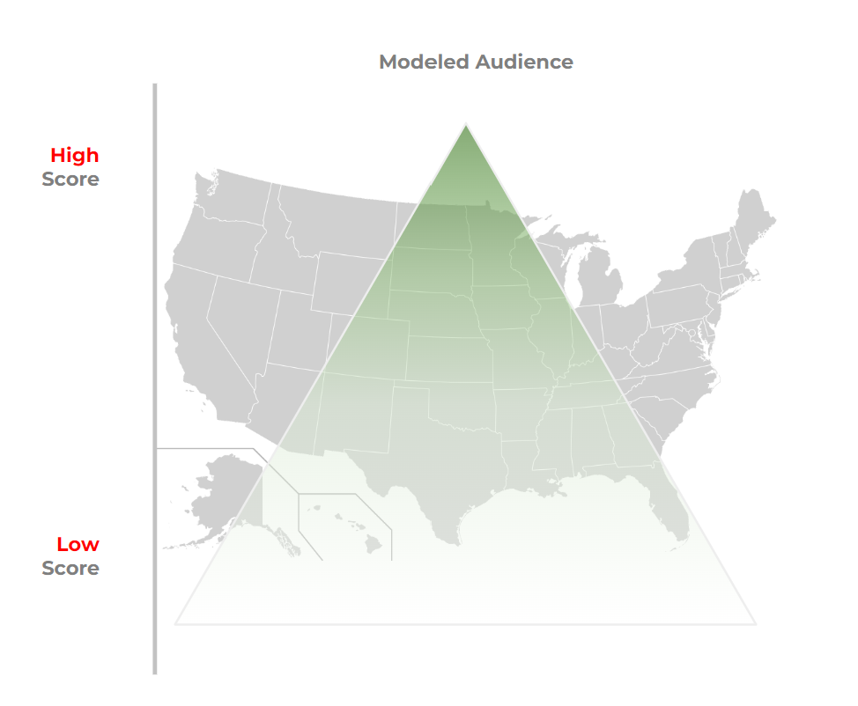
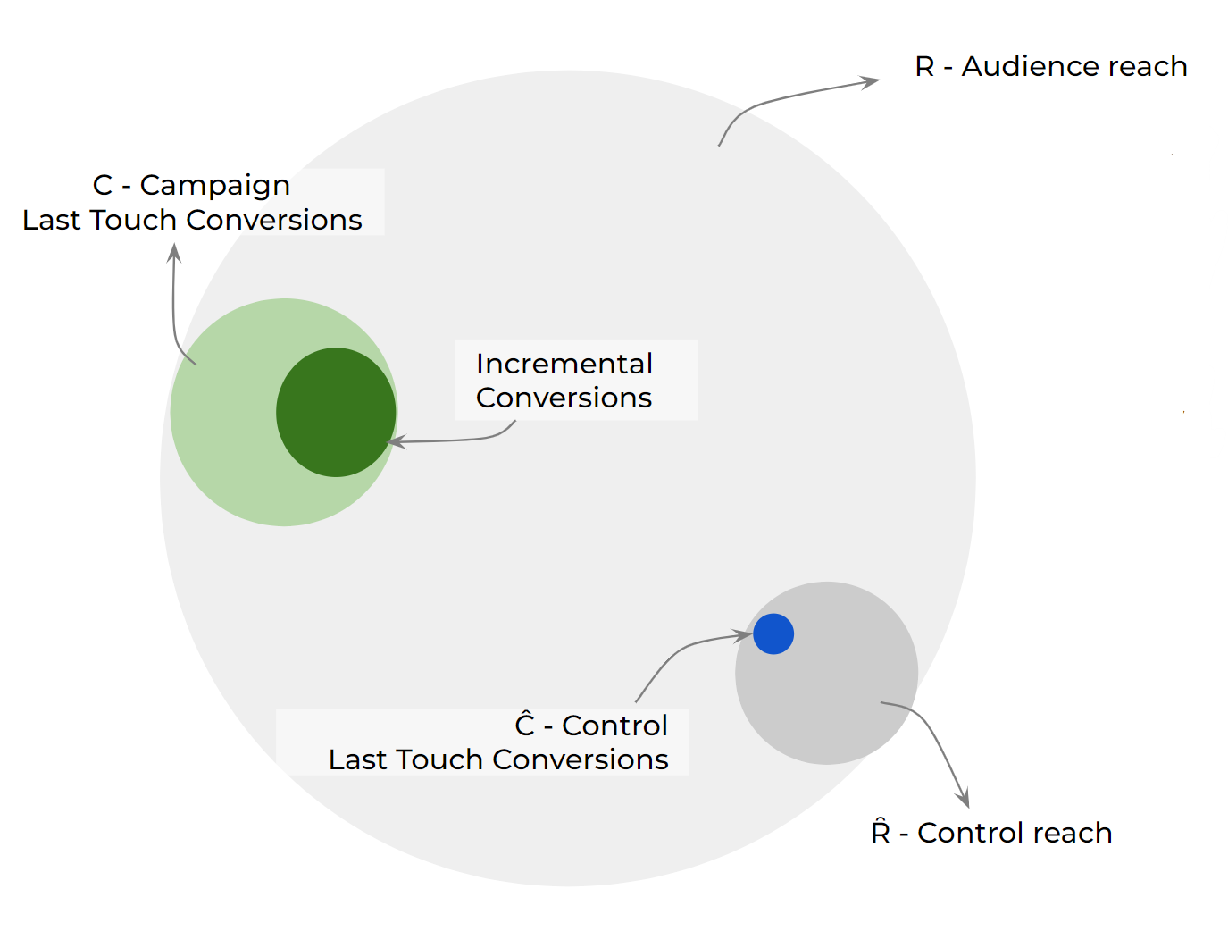
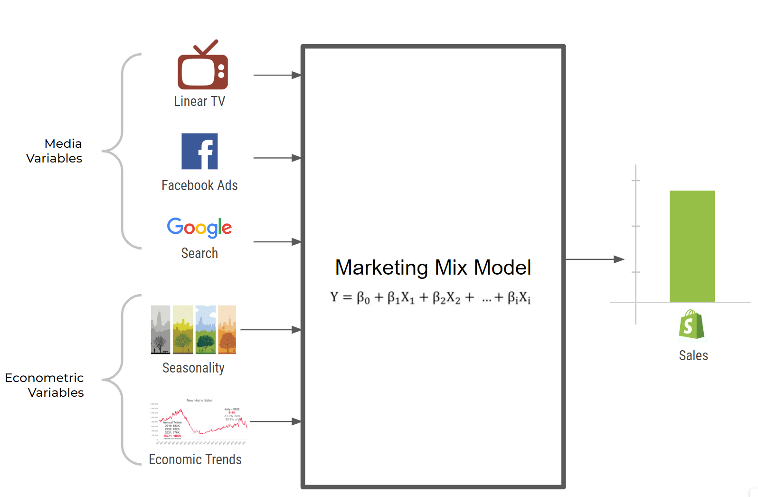
Two approaches to Causal Lift Measurement
Market Insight
---------------------------
Incrementality
Testing
Testing, both Geo and Split, is episodic by nature which means brands get point reads for a channel for a time period for a test.
Marketing mix models refresh cycles are usually quarterly, sometimes monthly.
Geo Match Market Testing
Split Testing
Marketing Mix
Modeling

Slide 16
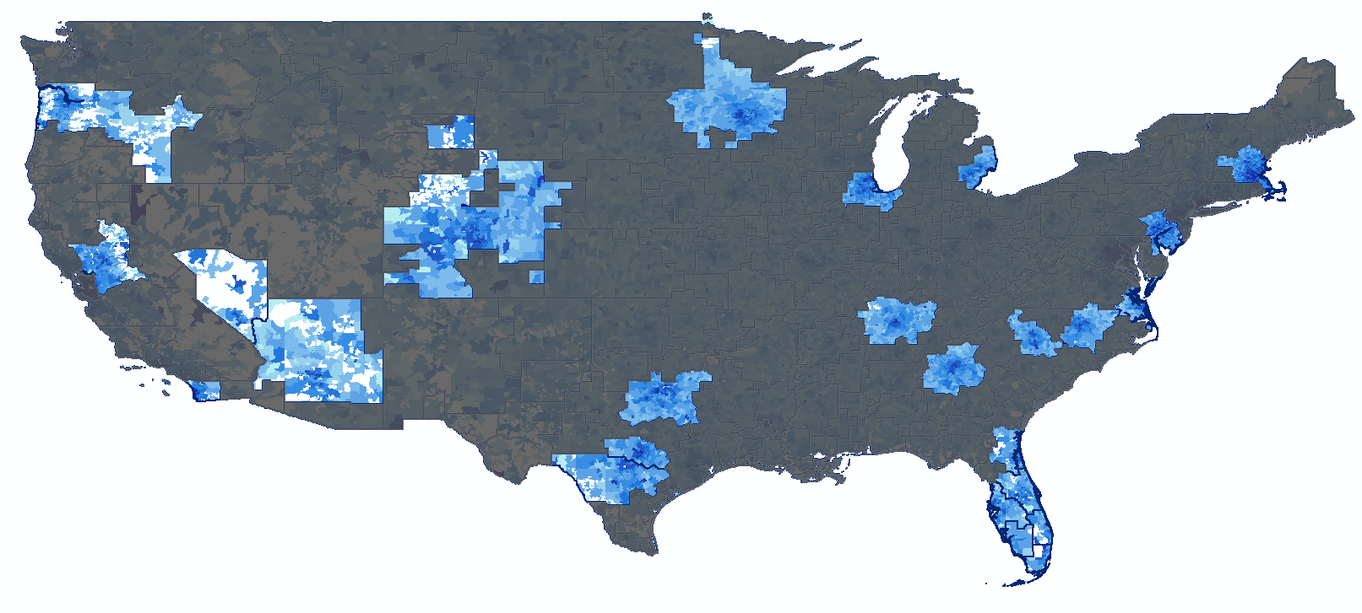

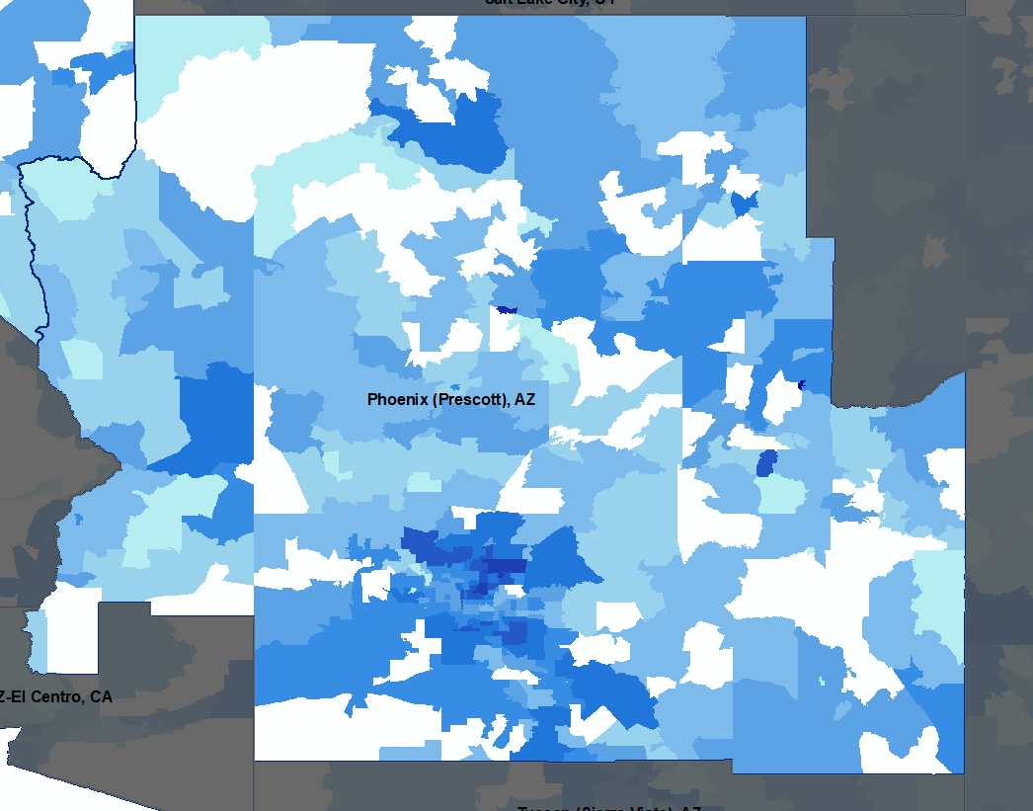
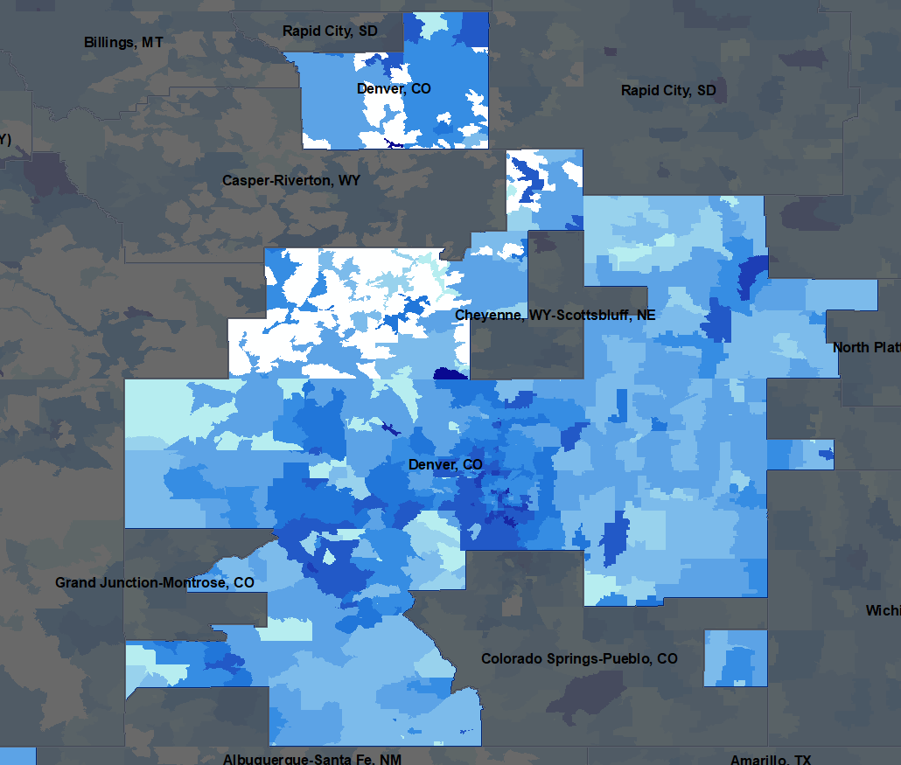
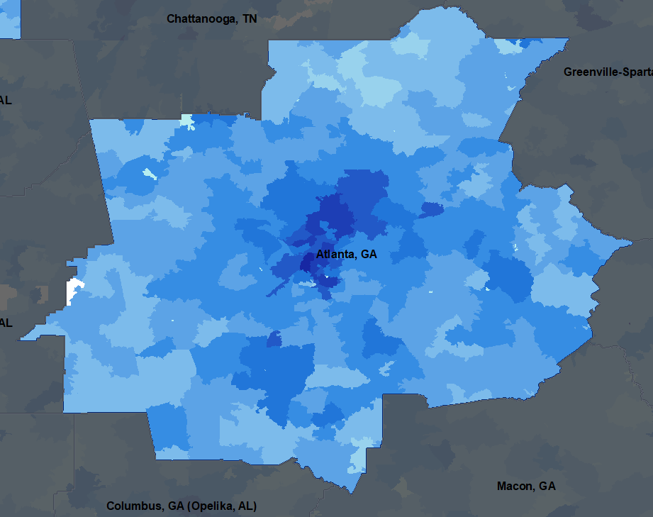
Let’s say you measure Lift using a Geo incrementality test
Treat the test zips with media+creative execution
Measured the lifted response in 1P data
Score zips for audiences using census data and your 1P data
Test Treatment
Channel Creative
1.3k
Lift
Test Market
Test Market
Control Market
Business-as-Usual
Phoenix, AZ
Denver, CO
Atlanta, GA
Control Treatment
Zip Codes
85942 86015 85253
Zip Codes
82640 80453 82084 80238 80473 80108 80007
Zip Codes
30327 30307 30005

Slide 17
You can calculate a Multiplier by comparing Causal Advanced Attributed Conversions to LastClick Base Attributed Conversions
2500
Base Attribution
Multiplier
vs Facebook’s Reporting
62%
2000
2.1k
Advanced Attribution
Calculate Multipliers by comparing Causal measured Outcomes with Last-click Attributed Outcomes
1500
1.3k
1000
500

Slide 18
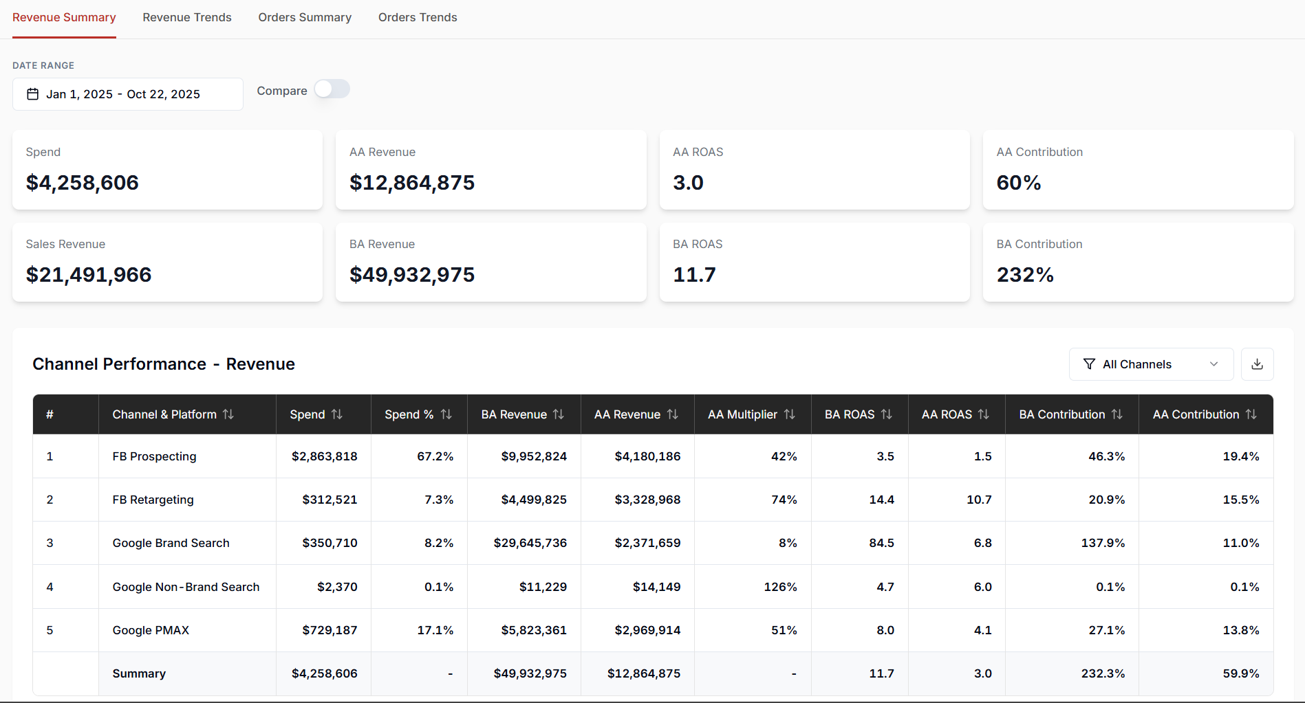
System of Advanced Attribution Multipliers to govern causality

Slide 19
Case Study

Slide 20
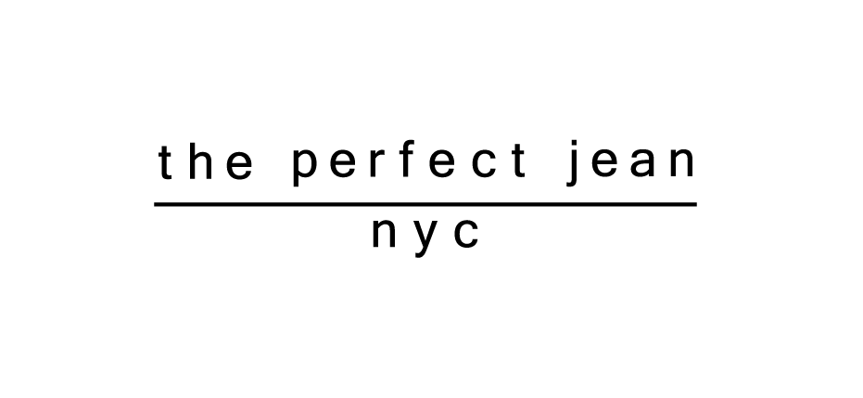
CASE STUDY
Using Advanced Attribution for data-driven media investment decisioning
DTC Fashion Brand

Slide 21






Meet Ovadia Labaton
DTC Leader & Entrepreneur
The Perfect Jean, Kidbox, Liquorbox, VC/PE roles
Ovadia Labaton
Co-Founder, The Perfect Jean

Slide 22
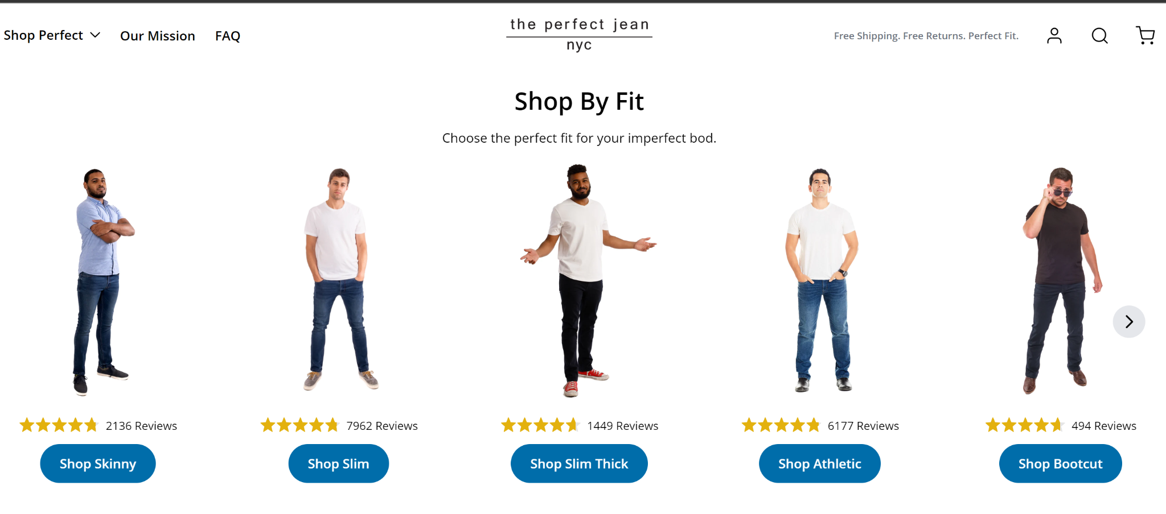
Live Case Study: Facebook & Tiktok test for The Perfect Jean
Brand Brief:
Fashion DTC Brand
Fast Growing Fashion eCommerce Brand | Startup
>30M/year GMV run rate
Direct-to-Consumer, eCommerce-only, No Retail stores
Growing ~2x YoY
~4 years old
Go-to-market Strategy:
Growth driver is primarily media
  Primarily Instagram/Facebook.
  Investing into TikTok, Google Shopping
Attribution:
Tools: NorthBeam
Consultants: M^2
https://theperfectjean.nyc/

Slide 23
Note
All data presented has been blinded to protect brand’s P&L confidentiality but preserve insights for educational purposes

Slide 24
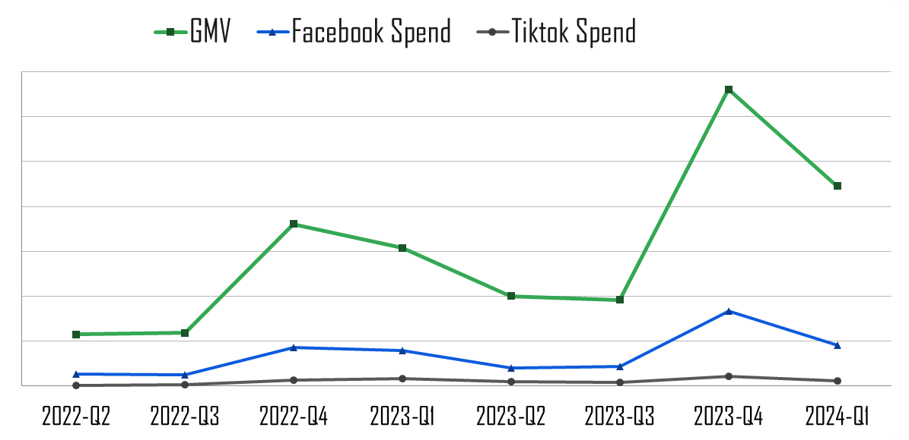
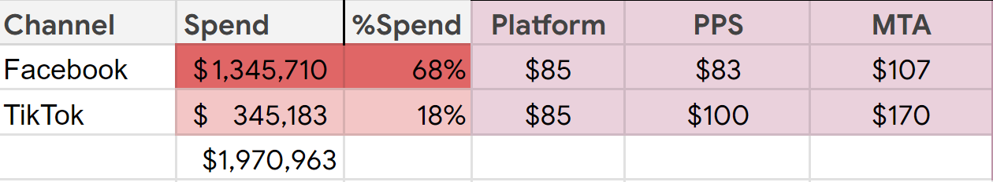
It’s Apr-May 2023 - what’s on Ovadia’s mind?
CPA
“What am I actually getting for the my Facebook and TikTok spend?”

Slide 25
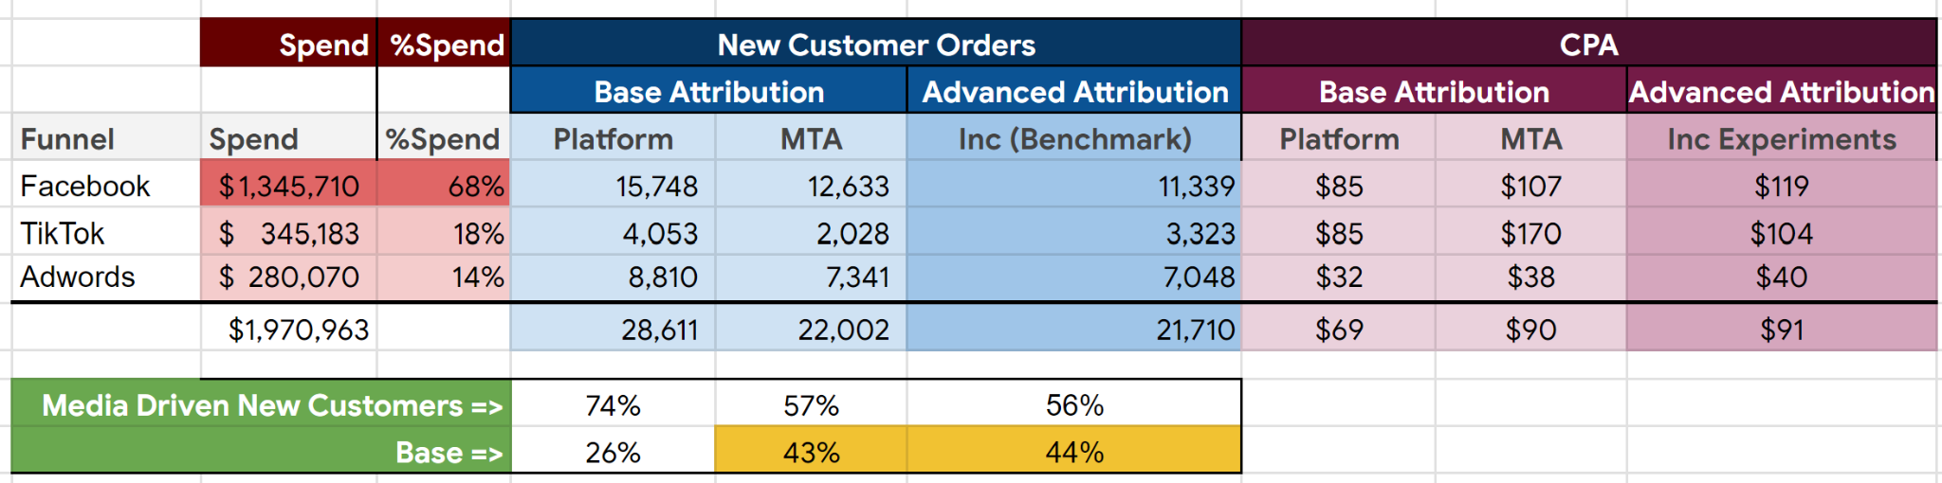

Triangulation Analysis - Base Attribution + Inc Multiplier Benchmarks
Managing to $100 CAC
Both Facebook and TikTok maybe close to their CPA headroom
New Customer baseline is around 44%
Understand Facebook and Tiktok contribution using Incrementality tests
Understand the base better using Marketing Mix Models
Next Steps

Slide 26

Geo Testing yielded results close to benchmark estimates
Base Attribution
Advanced Attribution
Platform Attribution
Post-Purchase
Survey
MTA
Geo Test
Multiplier
Lift
CPA
61%
$66
48%
$83
35%
$115
34%
$118
56%
Lift
CPA
12%
$77
9%
$100
5%
$176
9%
$99
77%

Slide 27
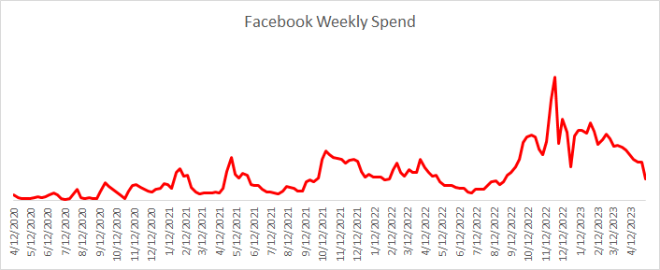

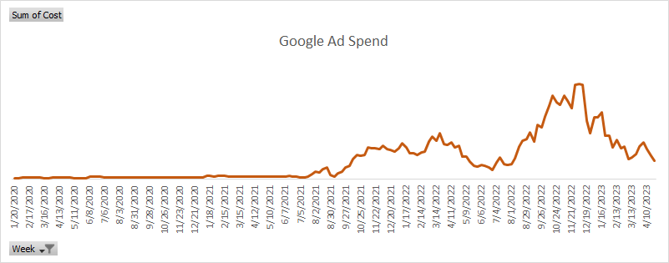

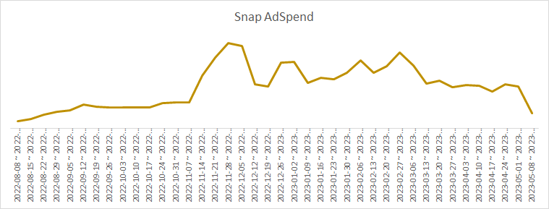
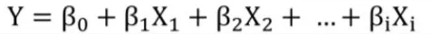
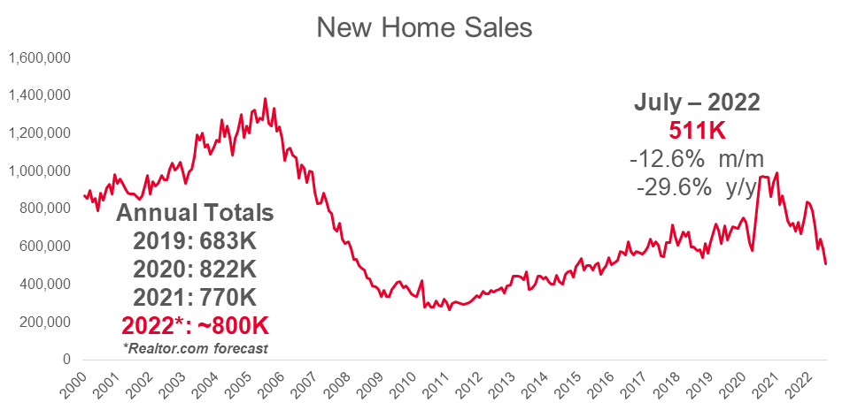
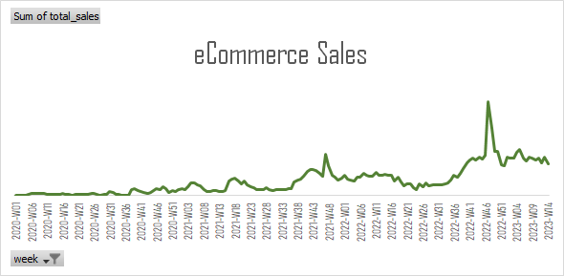


Marketing Mix Model (MMM) for TPJ
Marketing Mix Model
Facebook Ads
Media
Variables
Search Ads
Tiktok Ads
Trend
Econometric
Variables
Holiday
Season
Sales
Dependent variables:
New Customer Revenue
Sales (t-1)
Autoregressive
Variables
Sales (t-2)
…
MMM Library used
Facebook Robyn
Prior week Sales
Sales (t-6)

Slide 28
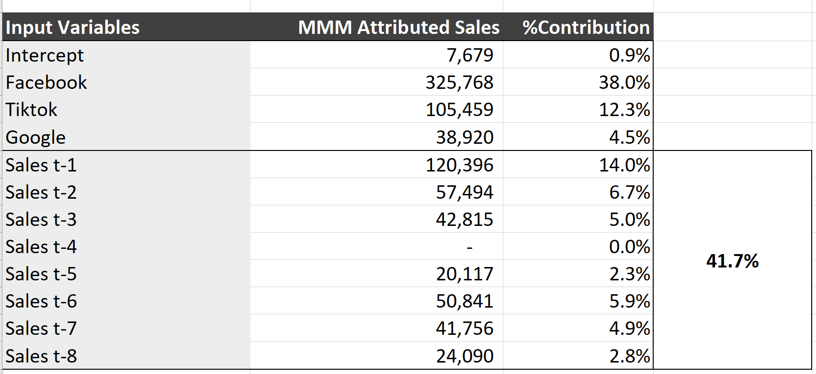
MMM decomposition of base opened up the understanding of consumer behavior
Momentum in the business
MMM’s allocation of credit to prior weeks of sales can be interpreted as momentum in the business. It turned out to be a significant ~42% of total sales.
Having the context that that media is the primary awareness driver for the brand in market, allowed TPJ to credit media for creating positive momentum for the business even if it is not directly attributable to short term sales.
Insight

Slide 29
If media is given credit for longer term momentum in the business,
CPAs are twice as efficient vs measured via Geo Test
Base Attribution
Advanced Attribution
Platform Attribution
Post-Purchase
Survey
MTA
Geo Test
Geo Test + Momentum
Lift
CPA
61%
$66
48%
$83
35%
$115
34%
$118
67%
$60
Lift
CPA
12%
$77
9%
$100
5%
$176
9%
$99
18%
$50

Slide 30

Boom! The market responded
~2x GMV growth YoY
~2x increase in media spend YoY

Slide 31
MODULE 2
Case study: Reading an Incrementality Test

Slide 32
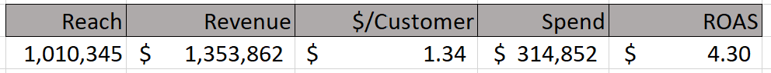
Case Study | “What is my ideal contact strategy to my file?”
Marketer: “I am an mature brand, primarily brick & mortar, gardening supplies brand.
I am not quite sure what Catalog is doing for me?
Can I go digital to my customers, will they respond?
What is the role of email?”
Notes:
Problem:
Business is trending -12% YoY going into BFCM
Brand has been spending on Facebook media for customer audiences, however they don’t know if the media is changing customer behavior to drive additional incremental purchases.
Brand has been using trial and error, and platform reported metrics to determine which audiences are eligible for Facebook media
Presently, client is targeting only 1x buyers who have not opened an email in 6 months with FB media.
Client wants to understand the difference in performance between conversion targeting and R&F targeting

Slide 33
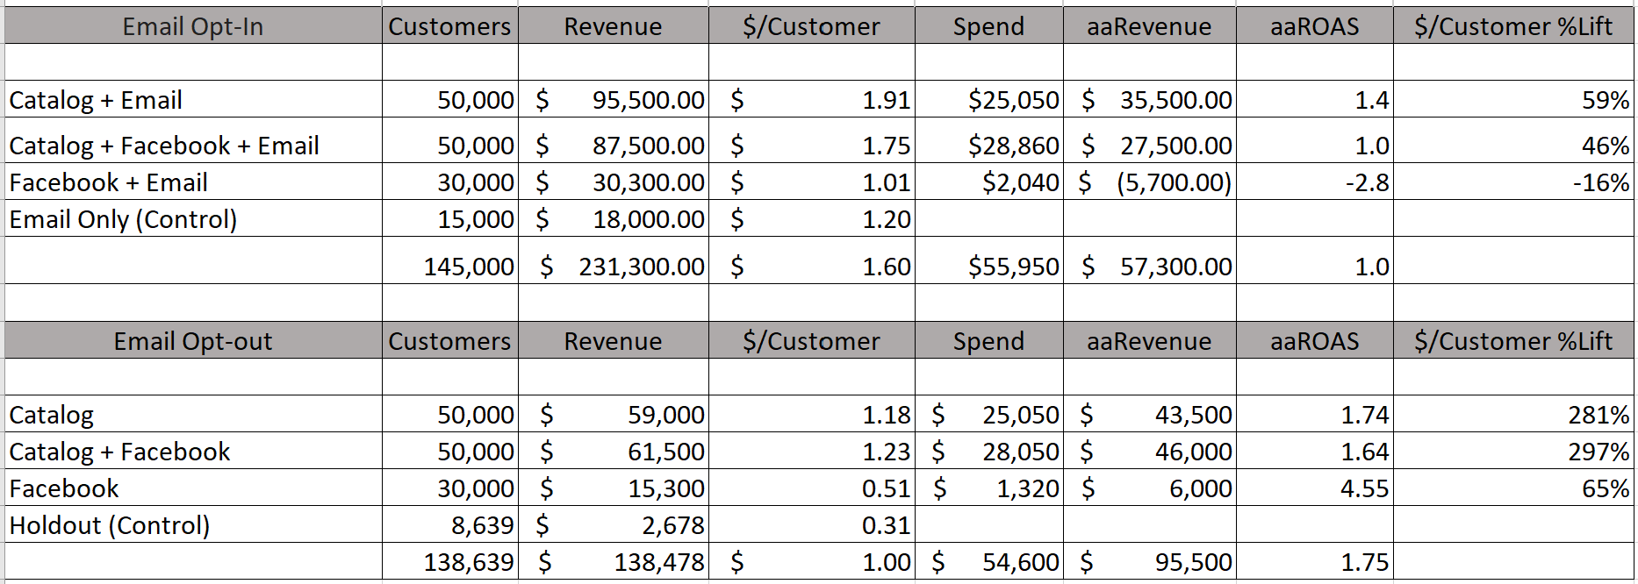
Case Study: “What is the role of email?”
Role of email
~287% lift
Notes:
Problem:
Business is trending -12% YoY going into BFCM
Brand has been spending on Facebook media for customer audiences, however they don’t know if the media is changing customer behavior to drive additional incremental purchases.
Brand has been using trial and error, and platform reported metrics to determine which audiences are eligible for Facebook media
Presently, client is targeting only 1x buyers who have not opened an email in 6 months with FB media.
Client wants to understand the difference in performance between conversion targeting and R&F targeting

Slide 34
Case Study | “Can I replace Catalog with Facebook?”
Catalog drives large lifts for opted out customers
Facebook is still very efficient
Notes:
Problem:
Business is trending -12% YoY going into BFCM
Brand has been spending on Facebook media for customer audiences, however they don’t know if the media is changing customer behavior to drive additional incremental purchases.
Brand has been using trial and error, and platform reported metrics to determine which audiences are eligible for Facebook media
Presently, client is targeting only 1x buyers who have not opened an email in 6 months with FB media.
Client wants to understand the difference in performance between conversion targeting and R&F targeting

Slide 35
Case Study | “Can I replace Catalog with Facebook?”
Only feasible contact strategy from a unit economics perspective
Catalog drives strong large lifts
Facebook annoys opted-in customers
Notes:
Problem:
Business is trending -12% YoY going into BFCM
Brand has been spending on Facebook media for customer audiences, however they don’t know if the media is changing customer behavior to drive additional incremental purchases.
Brand has been using trial and error, and platform reported metrics to determine which audiences are eligible for Facebook media
Presently, client is targeting only 1x buyers who have not opened an email in 6 months with FB media.
Client wants to understand the difference in performance between conversion targeting and R&F targeting

Slide 36
MODULE 3
Forecasting with Causal Metrics

Slide 37
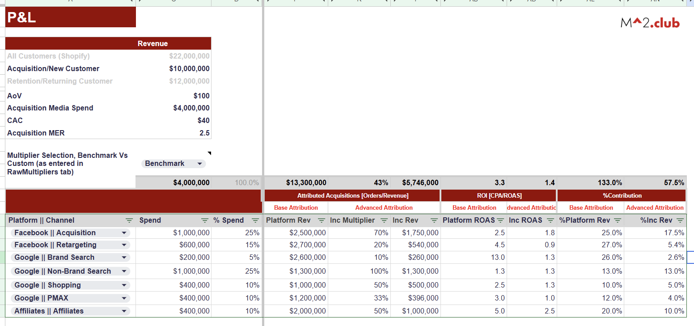

Forecasting with Causal Metrics
Notes:
Problem:
Business is trending -12% YoY going into BFCM
Brand has been spending on Facebook media for customer audiences, however they don’t know if the media is changing customer behavior to drive additional incremental purchases.
Brand has been using trial and error, and platform reported metrics to determine which audiences are eligible for Facebook media
Presently, client is targeting only 1x buyers who have not opened an email in 6 months with FB media.
Client wants to understand the difference in performance between conversion targeting and R&F targeting

Slide 38
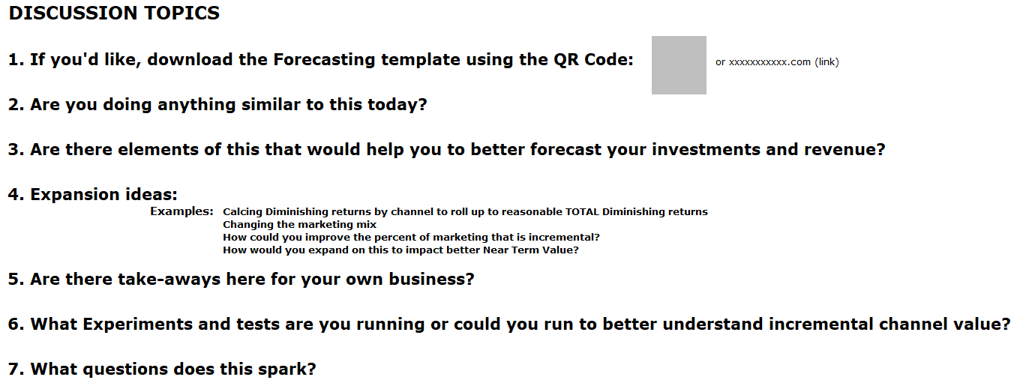
Discussion
Notes:
Problem:
Business is trending -12% YoY going into BFCM
Brand has been spending on Facebook media for customer audiences, however they don’t know if the media is changing customer behavior to drive additional incremental purchases.
Brand has been using trial and error, and platform reported metrics to determine which audiences are eligible for Facebook media
Presently, client is targeting only 1x buyers who have not opened an email in 6 months with FB media.
Client wants to understand the difference in performance between conversion targeting and R&F targeting

