Slide 1





Thursday, April 16th
Idea Incubator
Mastering Seamless, Cross-Channel Journeys with Customer Data Platforms
MODERATOR::
Susan McNamee
SVP Audience Planning
PANELIST::
Dana Springfield
CEO
PANELIST::
Alok Jain
Sr. Director –
Patient Relationship Management
PANELIST::
Richard Senzel
Senior Client Solutions Mgr.

Slide 2
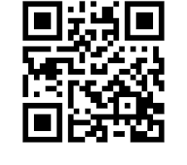
QUESTION 1
ARE YOU A MAILER?
YES
NO
Source: ChatGPT

Slide 3
QUESTION 2
IF YOU’RE A MAILER HOW LONG HAVE YOU BEEN IN THE MAIL?
MORE THAN 1 YEAR
LESS THAN 1 YEAR
Source: ChatGPT

Slide 4
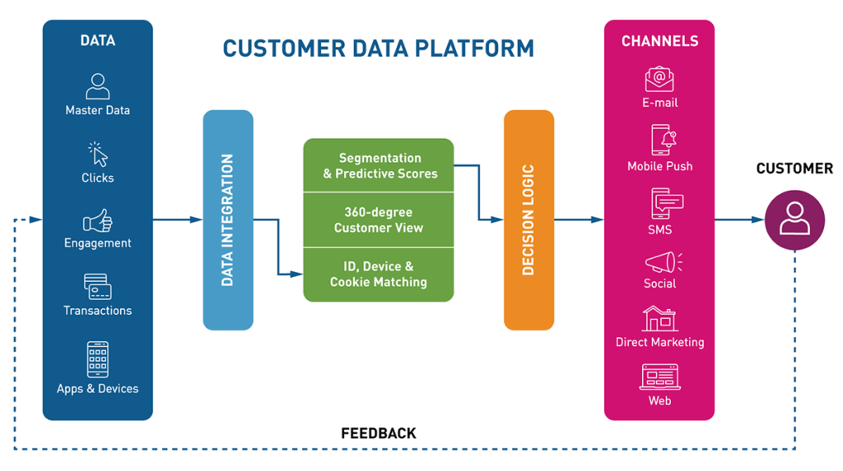
CDP OVERVIEW
Contact History
Response
Source: ChatGPT
Source: Striped Giraffe

Slide 5
QUESTION 3
HAVE YOU USED A CDP?
YES
NO
Source: ChatGPT

Slide 6
QUESTION 4
If YOU ANSWERED “NO” IS COST THE MAIN REASON?
YES
NO
Source: ChatGPT

Slide 7
QUESTION 5
WHERE IS YOUR ORGANIZATION TODAY WITH CUSTOMER DATA INTEGRATION?
VERY SILOED
SOMEWHAT CONNECTED
MOSTLY UNIFIED
FULLY UNIFIED
Source: ChatGPT

Slide 8
Q&A

Slide 9
THANKS!

