Slide 1

A Panel Discussion
Beyond the Basics:
Advanced Data-Driven Personalization
for Digital & Direct Mail

Slide 2
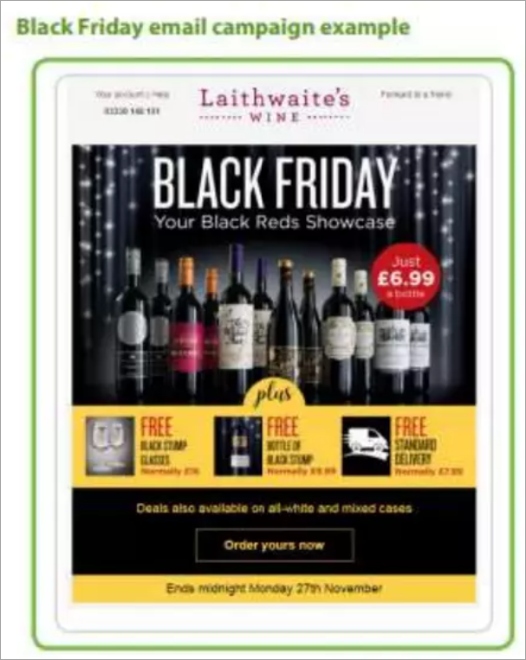
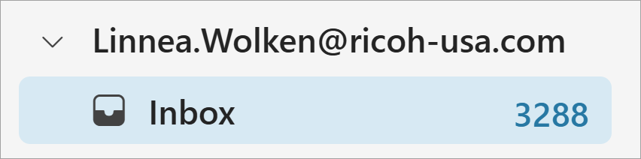
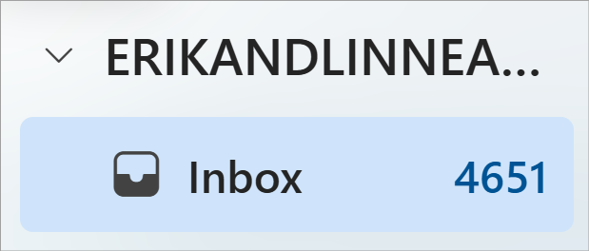
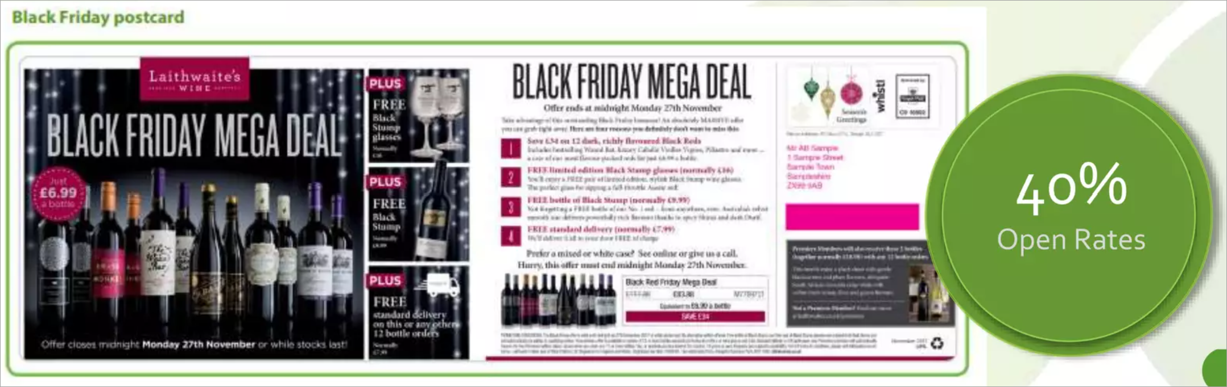
THE CHALLENGE?
CUTTING THROUGH THE CLUTTER.
Notes:
Personalization Examples
Consumer expectations are shifting: 71–76% expect personalized interactions, and frustration rises when they don’t receive them McKinsey & Company.

Slide 3
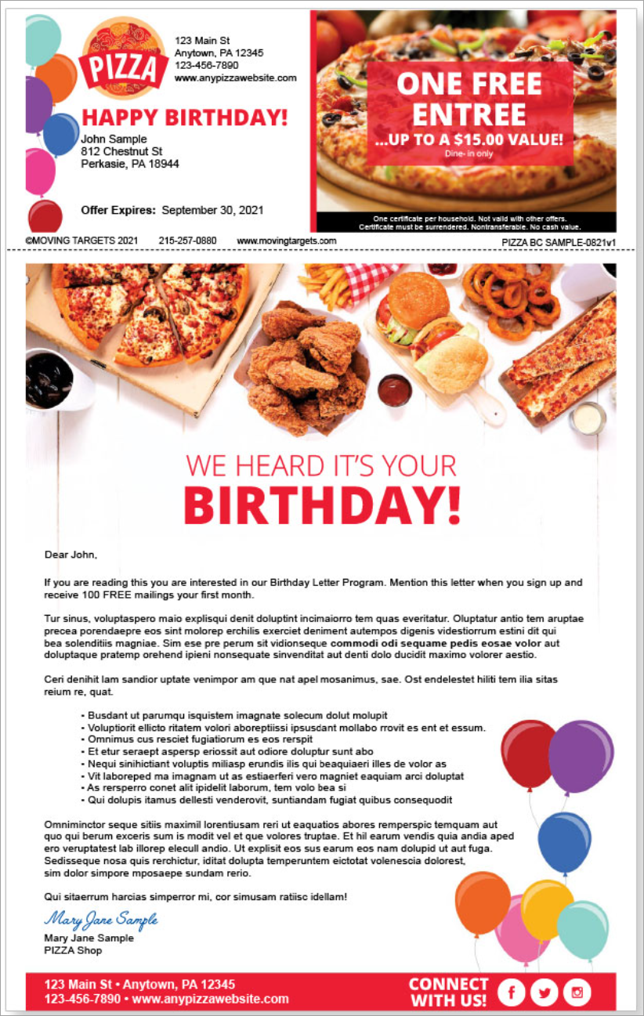
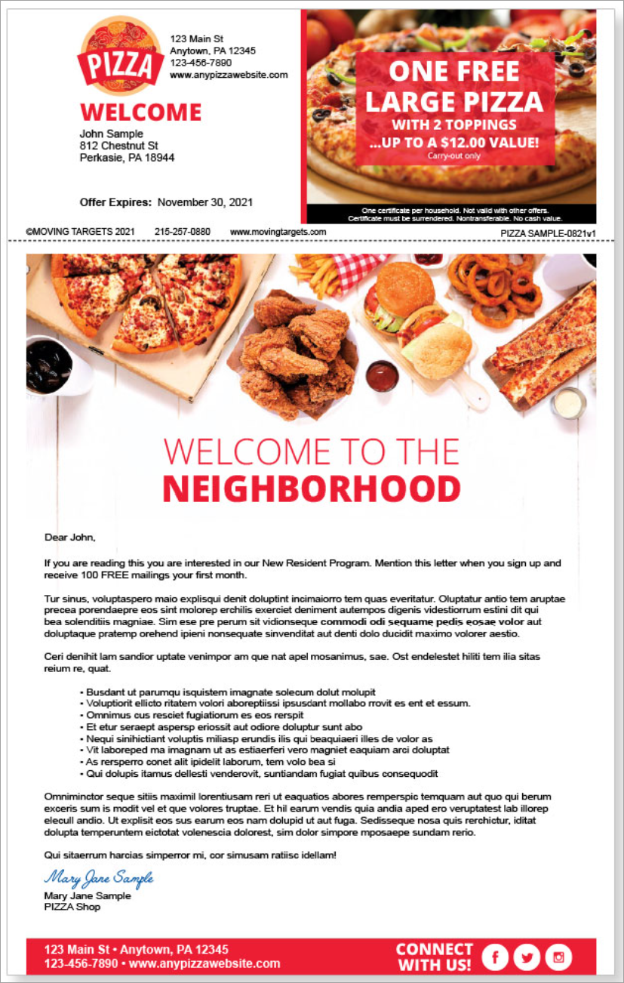
Notes:
Consumer expectations are shifting: 71–76% expect personalized interactions, and frustration rises when they don’t receive them McKinsey & Company.

Slide 4
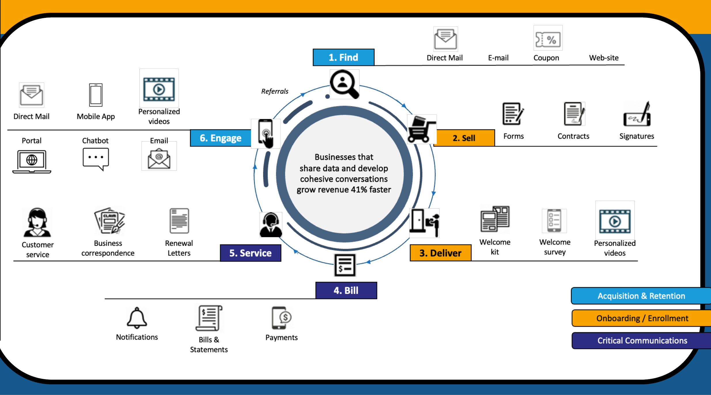
Craft a Personalized Customer Experience
Map the Customer Journey
ID Touchpoints & Data Capture
Deliver Relevant Content
Use Predictive Analytics
Notes:
Consumer expectations are shifting: 71–76% expect personalized interactions, and frustration rises when they don’t receive them McKinsey & Company.

Slide 5
POLL:
How would you describe your organization’s current level of personalization?
Uncertain or no personalization yet
Inconsistent across teams
Basic segmentation by audience or channel
Rule‑based personalization
Advanced personalization driven by data and testing
AI‑assisted personalization influencing decisions

Slide 6
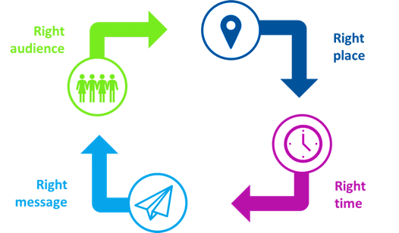
RIGHT PRODUCT

Slide 7

brands using advanced personalization see
16% higher conversions than those with basic personalization
U.S. consumers
spend 50% more with brands that tailor interactions to their needs
Deloitte research commissioned by Meta
Notes:
Impact Stats
Search Engine Journal.

Slide 8
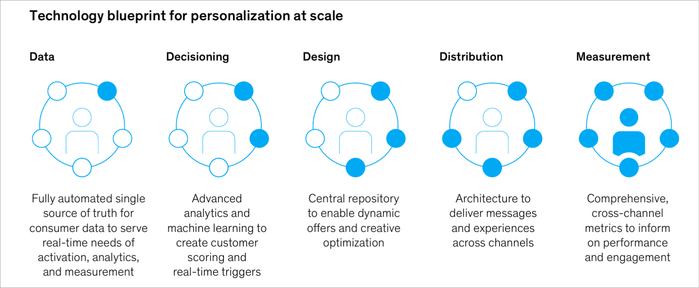

Slide 9
POLL:
Which best describes your organization’s current use of AI for personalization?
Not currently using AI
Using AI but not in marketing workflows
Using AI for marketing content and/or creative testing
Using AI for targeting and/or offer decisions
Using AI for orchestration across channels

Slide 10
Key Takeaways
Treat personalization as an operating model.
STOP DOING:
Advanced personalization starts with fewer, better decisions
DOUBLE DOWN ON:
Measurement is what determines whether personalization earns the right to scale.
AI CHANGES THE PERSONALIZATION MATH:
AI as a decision accelerator – by integrating across channels.

