Slide 1
Inside Your Issues:
A Policy Power Briefing from ACMA
The American Commerce Marketing Association (ACMA) is the voice of the direct and remote marketing industry.
As the primary voice for the direct marketing industry, we represent our members on such issues as consumer privacy; postal rates; regulations and service; trade; tax laws and regulations; and regulatory and Congressional relations.
Paul Miller, Executive Vice President & Managing Director
Lynn Noble, Vice President, Industry Relations

Slide 2
OVERVIEW: How Washington Is Rewriting the Rules and Economics for Marketers
Political and regulatory pressures are forcing businesses to adapt faster as lawmakers and regulators take a more active role in the marketing ecosystem.
Marketers are now at the center of major policy fights that directly affect business cost structures, customer reach, compliance burdens, and campaign performance.
Decisions made in Washington, and increasingly in the states are shaping the economics of both print and digital marketing.
The policy horizon is no longer a background issue. It is becoming a core business variable for marketers and the companies they support.

Slide 3
OVERVIEW: How Washington Is Rewriting the Rules and Economics for Marketers
Postal policy changes and shifting requirements are affecting direct mail strategy, delivery expectations, and the value of postal discounts.
Tariffs are increasing pressure on supply chains, input costs, and overall business planning, with downstream effects on marketing budgets and customer acquisition strategies.
Privacy laws are continuing to evolve, creating new compliance obligations and changing how marketers collect data, target audiences, and measure results.
Taxes: Remote sales tax remains a top ACMA priority following the 2018 South Dakota v. Wayfair decision.
Since the 2018 Supreme Court Wayfair ruling, state tax expansion continues to outpace federal clarity, leaving companies exposed to growing complexity and risk.

Slide 4
Postal Pricing and Catalog Mail
The USPS has proposed new mailing services price changes to take effect July 12, 2026, with overall mailing services prices rising by about 4.8%.
For marketers, the practical takeaway is simple: mail is getting more expensive again, putting added pressure on circulation strategy, format decisions, and return on marketing spend.
“Catalog Insights” promotion expires June 30th. From 10/1/25 to 6/30/26, catalog mailers gained a 10% discount just for checking off a catalog box on postal form.
In July rate change, USPS offers a considerably smaller mail incentive.
Even modest postal increases can force marketers to rethink volume, targeting, frequency, and customer acquisition math.

Slide 5
USPS Rate Increase – July ’26
Marketing Mail Letters
Average increases around 5.47%–6.5%
Stronger discounts for commingling and deeper presort levels
Increased drop ship discounts (now up to $21/M for SCF entry)
Greater savings opportunity when moving from 3-digit to 5-digit presort
Marketing Mail Flats (Catalogs & Magazines)
More moderate increases, averaging ~1.5%–4.87% for lighter pieces
Heavier pieces (4oz+) may see higher increases without drop shipping
SCF drop ship discounts improved slightly
New 20 oz weight limit (up from 16 oz)
Big Shift: Catalog Promotion Ending
The 10% USPS Catalog Promotion ends June 30, 2026
It was replaced by a smaller incentive

Slide 6
Variance Year over Year-Flats
 |  | SCF | SCF | % Change
ECR | Basic SCF Pallet | $0.437 | $0.431 | -1.37%
ECR | Basic 5-Digit Container | $0.430 | $0.424 | -1.40%
ECR | Basic | $0.463 | $0.463 | 0.00%
ECR | High Density SCF Pallet | $0.362 | $0.341 | -5.80%
ECR | High Density 5-Digit Container | $0.347 | $0.324 | -6.63%
ECR | High Density | $0.380 | $0.363 | -4.47%
ECR | High Density+ SCF Pallet | $0.296 | $0.311 | 5.07%
ECR | High Density+ 5-Digit Container | $0.286 | $0.299 | 4.55%
ECR | High Density Plus | $0.313 | $0.332 | 6.07%
ECR | Saturation SCF Pallet | $0.246 | $0.259 | 5.28%
ECR | Saturation 5-Digit Container | $0.231 | $0.241 | 4.33%
ECR | Saturation | $0.252 | $0.267 | 5.95%
 |  | DDU | DDU | % Change
ECR | Basic SCF Pallet | $0.426 | $0.415 | -2.58%
ECR | Basic 5-Digit Container | $0.419 | $0.415 | -0.95%
ECR | Basic | $0.452 | $0.454 | 0.44%
ECR | High Density SCF Pallet | $0.351 | $0.332 | -5.41%
ECR | High Density 5-Digit Container | $0.336 | $0.315 | -6.25%
ECR | High Density | $0.369 | $0.354 | -4.07%
ECR | High Density+ SCF Pallet | $0.285 | $0.302 | 5.96%
ECR | High Density+ 5-Digit Container | $0.275 | $0.290 | 5.45%
ECR | High Density Plus | $0.302 | $0.323 | 6.95%
ECR | Saturation SCF Pallet | $0.235 | $0.250 | 6.38%
ECR | Saturation 5-Digit Container | $0.220 | $0.232 | 5.45%
ECR | Saturation | $0.241 | $0.258 | 7.05%

Slide 7
Year Over Year Variance-Letters
Sort | Type | None | None | % Change
ECR | High Density | $ 0.360 | $ 0.384 | 6.67%
ECR | High Density Plus | $ 0.270 | $ 0.281 | 4.07%
ECR | Saturation | $ 0.239 | $ 0.250 | 4.60%
Sort | Type | SCF | SCF | % Change
ECR | SCF Pallet Discount | $ (0.003) | $ (0.003) | 0.00%
ECR | High Density | $ 0.343 | $ 0.363 | 5.83%
ECR | High Density Plus | $ 0.253 | $ 0.260 | 2.77%
ECR | Saturation | $ 0.222 | $ 0.229 | 3.15%
 |  | Prior | 7/12/2026
Sort | Type | None | None | % Change
ECR | High Density | $ 0.365 | $ 0.389 | 6.58%
ECR | High Density Plus | $ 0.275 | $ 0.286 | 4.00%
ECR | Saturation | $ 0.244 | $ 0.255 | 4.51%
Sort | Type | SCF | SCF | % Change
ECR | SCF Pallet Discount | $ (0.003) | $ (0.003) | 0.00%
ECR | High Density | $ 0.348 | $ 0.368 | 5.75%
ECR | High Density Plus | $ 0.258 | $ 0.265 | 2.71%
ECR | Saturation | $ 0.227 | $ 0.234 | 3.08%

Slide 8
Catalog Insights Promotion
ACMA successfully secured the promotion with the intent to isolate catalog behaviors and sensitivities to price in contrast to other types of mail.
Early USPS feedback suggests the promotion drew strong interest not only from traditional catalog mailers, but also from business mailers that modified mail piece design to qualify under the postal definition of a catalog.
Catalog Insights was set as a 9-month promo. USPS promotions are temporary by design.
ACMA is staying closely engaged with USPS through MTAC and direct ongoing discussions to push for more workable, long-term outcomes for catalog mailers and the broader marketing community.

Slide 9
Catalog Insights Promotion: The Outcomes
Tariffs caused inventory uncertainty and disrupted planning. This effectively skewed everything.
Migration from other types of mailers (eg: periodicals, sale flyers were minimally changed for the purpose of getting the discount)
Implementation timing didn’t allow enough runway for new entrants.
  Only established catalog mailers could realistically adjust because of their existing infrastructure.
Seasonal mix reduced impact during peak measurement periods (eg: apparel mailers peak in spring not holiday).
The timing coincided with the Postmaster General’s March 17th appearance on Capitol Hill before the House Oversight Committee.

Slide 10
USPS Throws a Bone: 2 New Promotions
Impact Messaging: Provides a discount for campaigns that promote the Postal Service and mail.
Direct Mail Discovery: For new Direct Mail customers that provides a discount off the first 5,000 pieces and a credit to an eDocSubmitter.
The already-existing Tactile, Sensory and Interactive will have two tiers of discounts to incent customer behavior.
DISCONTINUED: Continuous Contact and Catalog Insights.

Slide 11
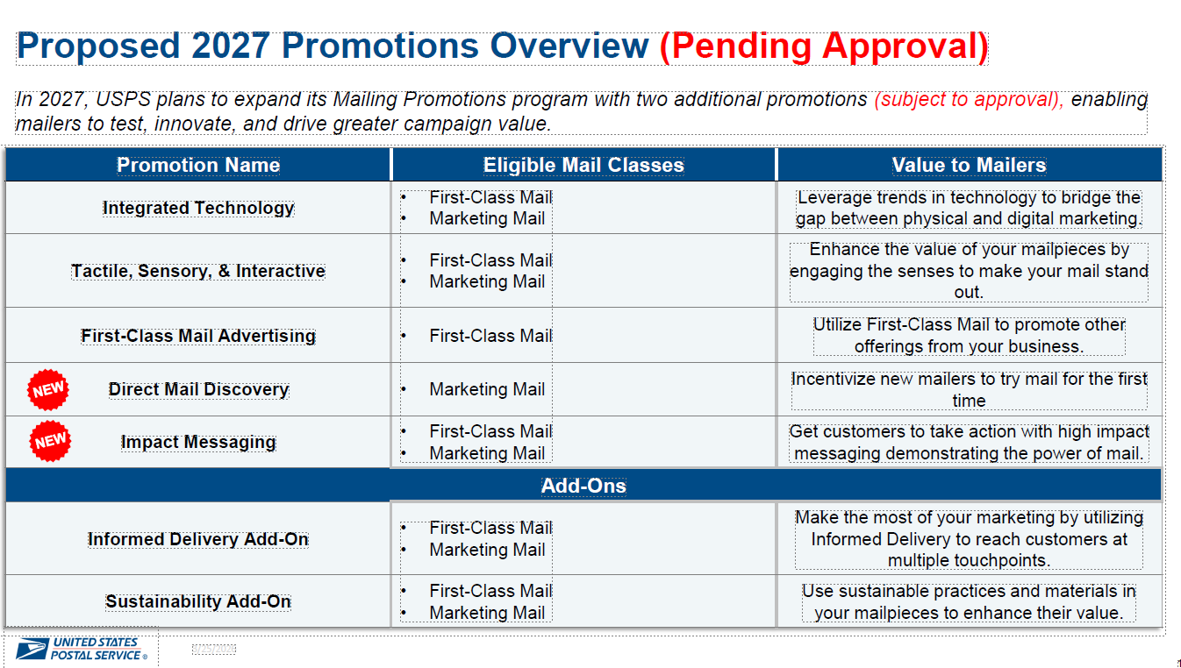

Slide 12
Tariffs Have Reshaped Marketing Strategies.
Oh Wait…Here Come the Refunds…Um Maybe.
Tariffs have been the “wild card” that has thrown nearly every merchant into an even greater period of chaos.
Following the February Supreme Court ruling that determined President Trump’s International Emergency Economic Powers Act tariffs to be illegal, ACMA has been in close contact with our legal and lobbying firms to determine how those of you who paid them might be able to get refunds.
Customs & Border Protection (CBP) is developing a new automated tool to process the large volume of IEEPA refunds, using its Automated Commercial Environment (ACE).

Slide 13
Tariffs Refunds Schedule
CBP will issue IEEPA refunds in phases. In Phase 1, CBP will be issuing IEEPA refunds for certain unliquidated entries and certain liquidated entries up to 80 days past their liquidation date.
The new tool for processing IEEPA refunds is called “Consolidated Administration and Processing of Entries” (CAPE).
Starting next week, importers or their brokers, may start using CAPE to request IEEPA tariff refunds for eligible entries. No other party is authorized to request IEEPA tariff refunds.
Importers and authorized brokers should anticipate that valid IEEPA refunds will generally be issued within 60 - 90 days following acceptance of the CAPE Declaration, unless a compliance concern requires further CBP review.
Importers of record (IORs) and brokers should ensure they have an ACE Portal account and that their bank account information for refunds has been added to their account.

Slide 14
Tax and Privacy: The Long Game for Marketers
Remote sales tax remains a top ACMA priority following the 2018 South Dakota v. Wayfair decision.
ACMA’s core objective is still federal legislation to simplify compliance so remote sellers are not forced to navigate more than 12,000 state and local tax jurisdictions.
The biggest challenge is that states have interpreted Wayfair differently, creating a fragmented, state-by-state compliance landscape for businesses selling across state lines.
In many cases, states have used Wayfair not just to require sales tax collection, but to justify attempts to impose other taxes, including business income taxes and related obligations, on remote sellers.
That has increased legal uncertainty, administrative burden, and compliance costs for companies that may have little or no physical presence in those states.

Slide 15
Tax and Privacy: The Long Game for Marketers
ACMA has pushed back directly in the courts, including a successful case against the California Franchise Tax Board, where it invalidated state publications that limited federal protections for remote sellers.
ACMA is also involved in similar litigation in New York and New Jersey, underscoring that this is not a one-state issue but a broader national trend.
The larger concern for marketers and remote businesses is that state tax expansion continues to outpace federal clarity, leaving companies exposed to growing complexity and risk.

Slide 16
Tax and Privacy: The Long Game for Marketers
Consumer privacy protection laws represents another runaway train of sorts. More than a third of the states have various levels of comprehensive state data privacy laws, which results in compliance costs and regulatory burdens for businesses that operation nationwide.
As with tax, our thrust here has been to gain federal legislation to reduce these burdens while strengthening consumer data protection.
Difficulty in gaining traction on this issue because “privacy” means something different to everyone you talk to in Washington. Expansion of AI only adds greater complexity to what warrants “privacy” concerns.

Slide 17
The ACMA & You
ACMA’s role is to cut through the noise, track the issues that matter most, and advocate for policies that protect and advance the interests of marketers.
Acting as an industry coalition is essential; collective engagement carries more weight with policymakers than individual companies acting alone.
Businesses need to understand not only what is happening legislatively, but also where and how you can engage to influence outcomes.
Local action matters alongside federal advocacy, especially as states play a larger role in shaping privacy, postal, and marketing-related policy.
The marketers who stay ahead of policy and regulatory changes will be better positioned to protect their business strategies, insulate their economics, and adapt before disruption hits the bottom line.

Slide 18
The ACMA & You
ACMA’s role is to protect your business from harmful policy decisions coming out of Washington. Membership matters and the real influence comes from having engaged businesses in more congressional districts. The more local voices ACMA can activate, the more effective we are with lawmakers.
Lawmakers pay closest attention to the businesses and employers in their own districts. When key votes arise, outreach from a constituent can help move a member of Congress in ways outside advocates cannot.
That is especially important when legislation is being shaped by committee chairs and rank-and-file members with direct influence over the outcome.

Slide 19
The ACMA & You
Advocacy is not just about passing good legislation; it is also about stopping harmful proposals before they gain momentum.
  EXAMPLE: For much of the 2010s, the ACMA protected the benefits from the 1992 Quill v. North Dakota precedent until losing by a 5-4 margin in South Dakota v. Wayfair in 2018.
  If not for ACMA’s actions, Quill would have been overturned upwards of 10 years earlier.
  ACMA members saved a fortune in costs, manpower, and the like while Quill continued to hang on.
Policy wins happen vote by vote, office by office, and district by district.
Your involvement gives ACMA more credibility, more reach, and more leverage where it counts most.

Slide 20

ACMA National Forum: A Can’t Miss

Slide 21
Inside Your Issues:
A Policy Power Briefing from ACMA
CONTACT:
Paul Miller, pmiller@commercemarketing.org 914-669-8391
Lynn Noble, lnoble@commercemarketing.org 513-608-4749

